Slide 1

GEOG 4/590: Geospatial Data Science
Lecture 4: Gridded data analysis
Email: jryan4@uoregon.edu
Office: 163A Condon Hall
Office hours: Mondays 14:00-16:00

Slide 2
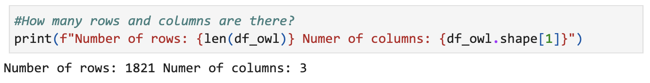
Code review: Assignment 2 and Activity 2
Notes:
Dana - What formatting is used here? “Formatted string literals” of “f-strings”. Like it when students provide answers in this format. No extra marks but just sets the right tone – it’s not much extra effort. Writing in a helpful way.

Slide 3
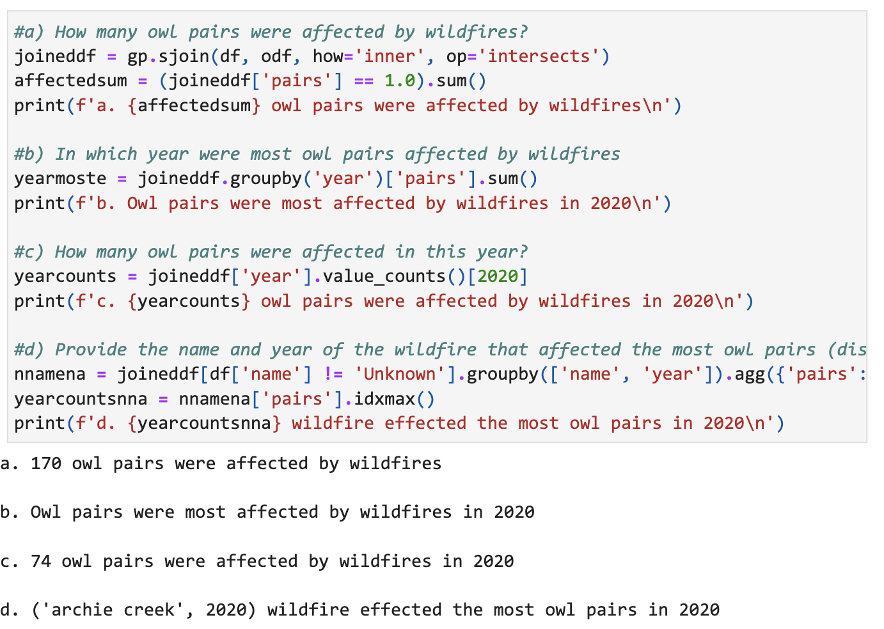
Code review: Assignment 2 and Activity 2
Notes:
Makayla - even better!

Slide 4
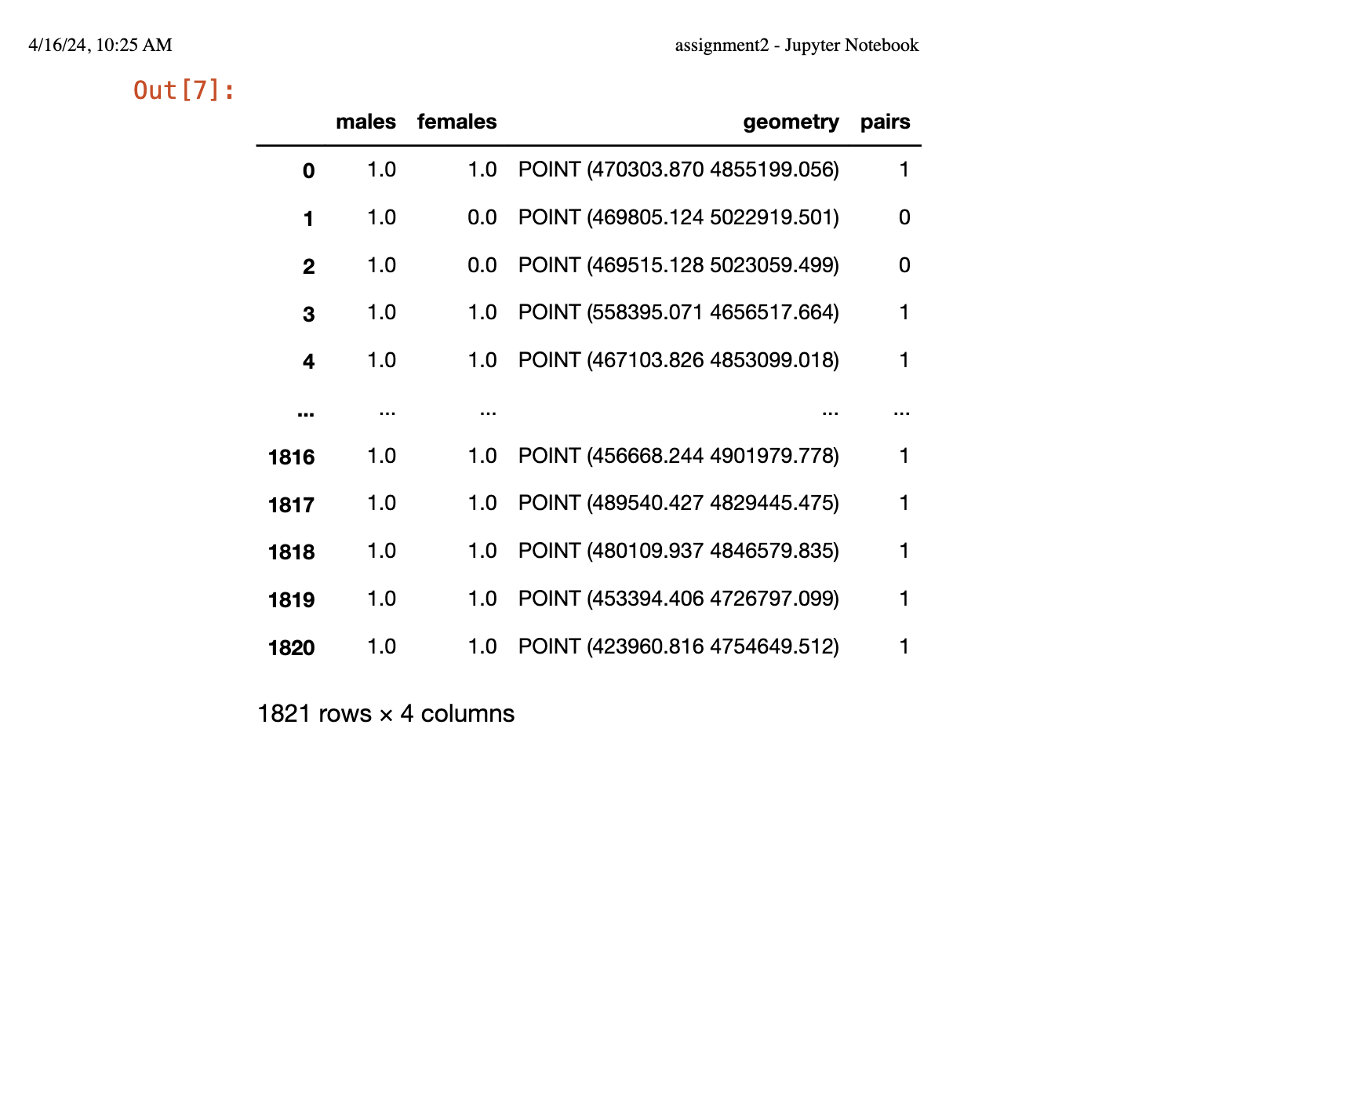
Code review: Assignment 2 and Activity 2
Notes:
Anneke– stuff like this should not appear in your notebook - a couple are guilty of this. Useful to you – yes but, before you submit, go through notebook to make sure none of this kind of stuff is in there - not helpful to me.

Slide 5
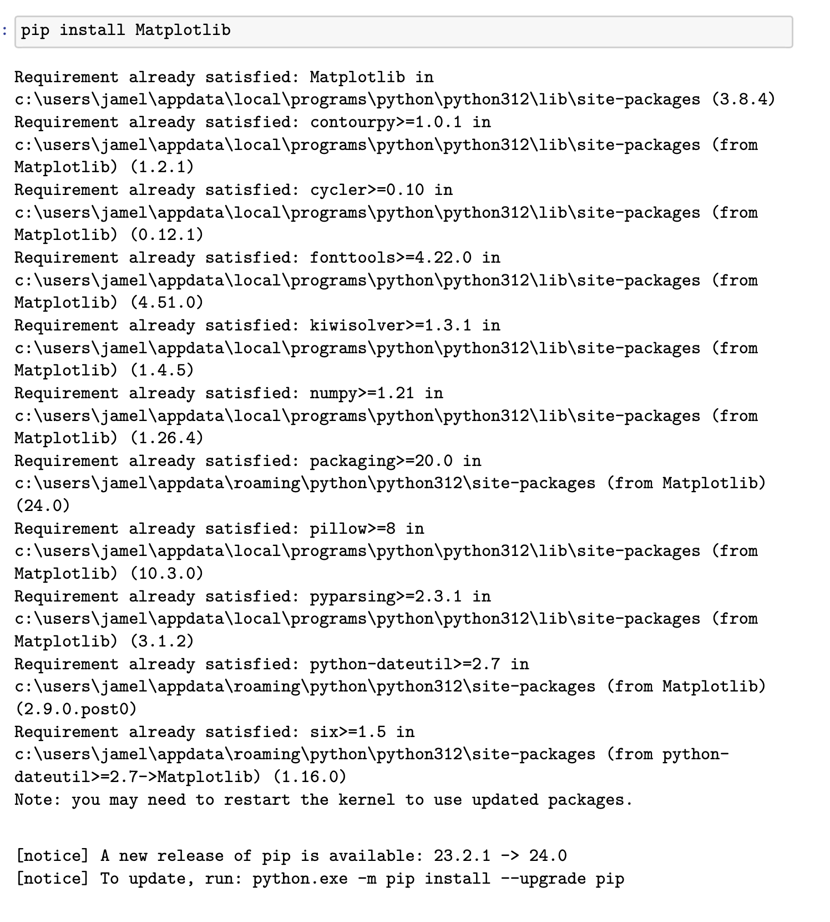
Code review: Assignment 2 and Activity 2
Notes:
Jamal – no!

Slide 6
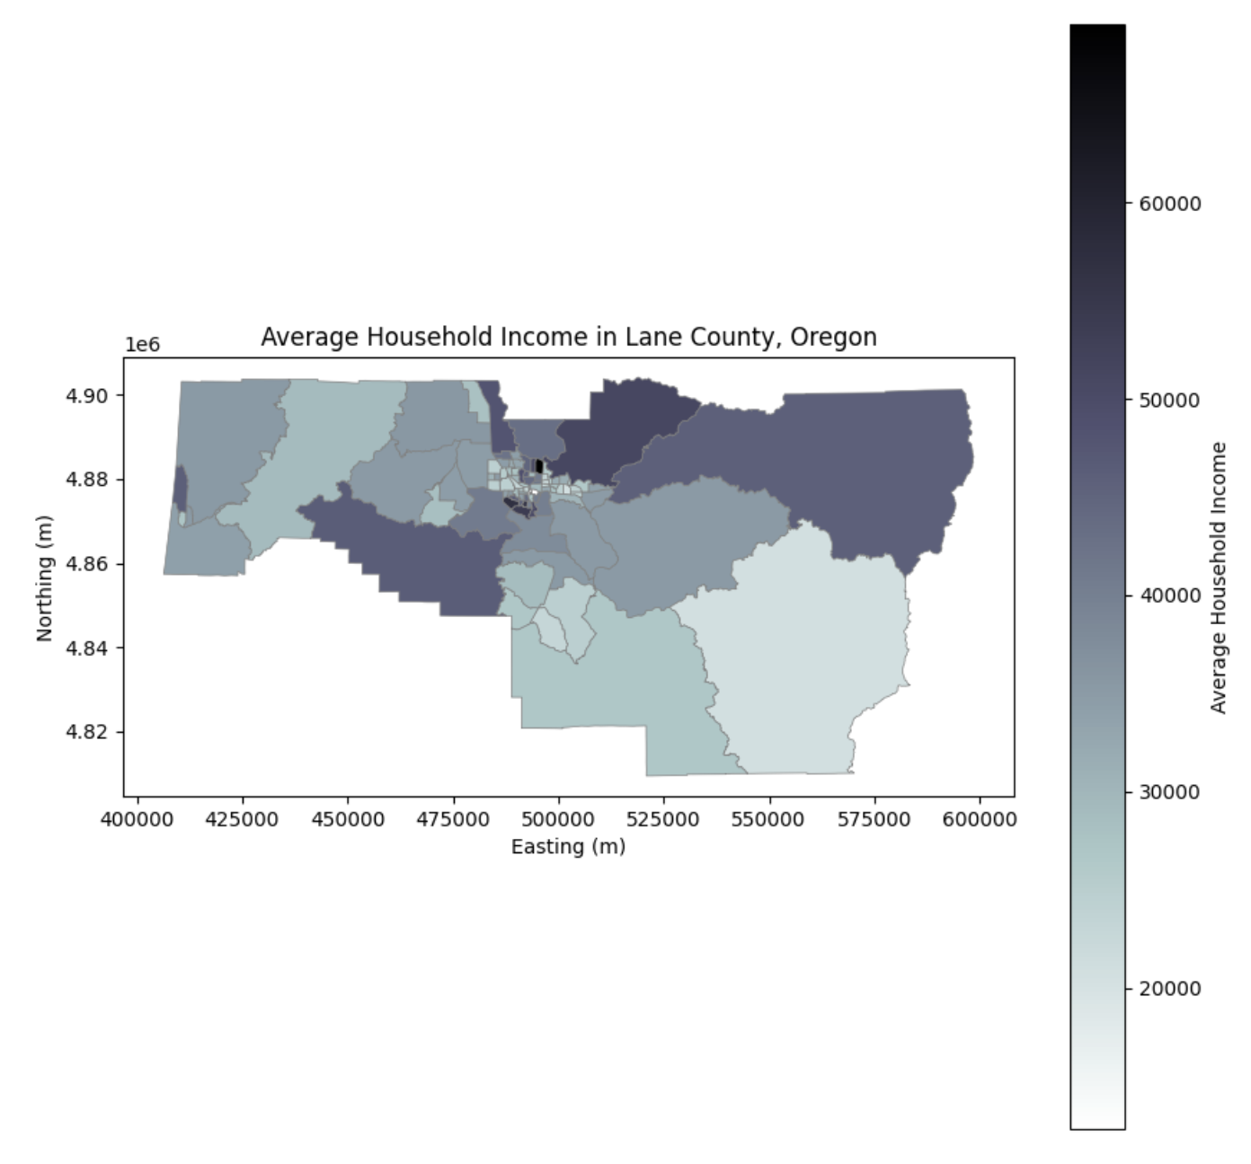
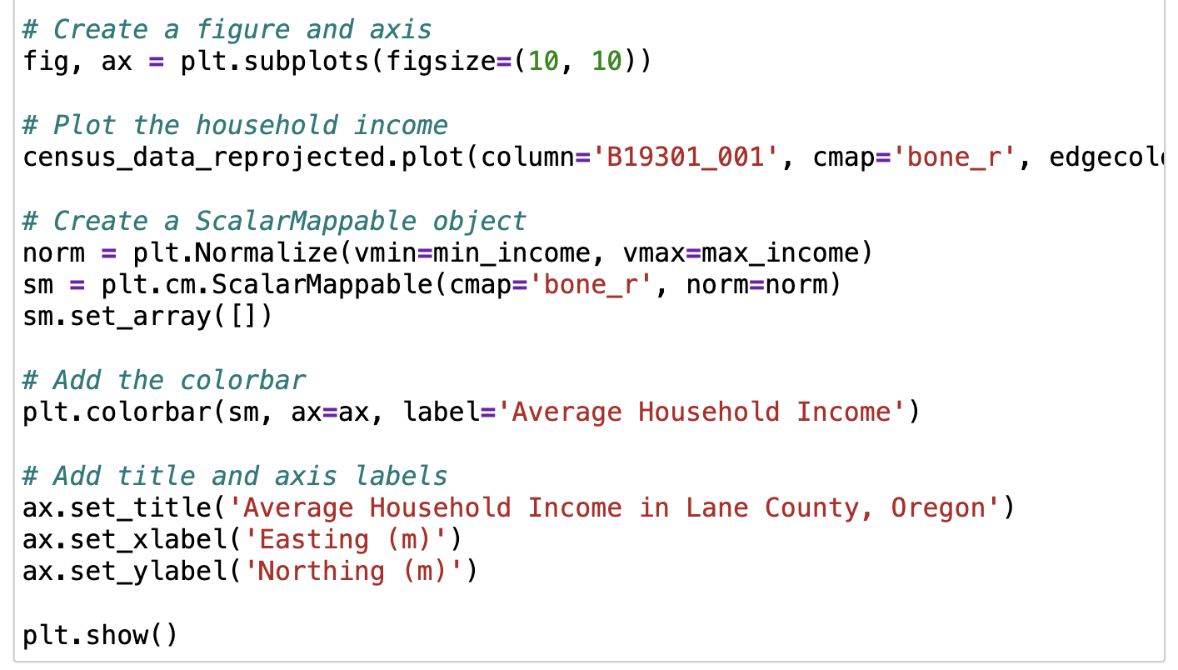
Code review: Assignment 2 and Activity 2

Slide 7
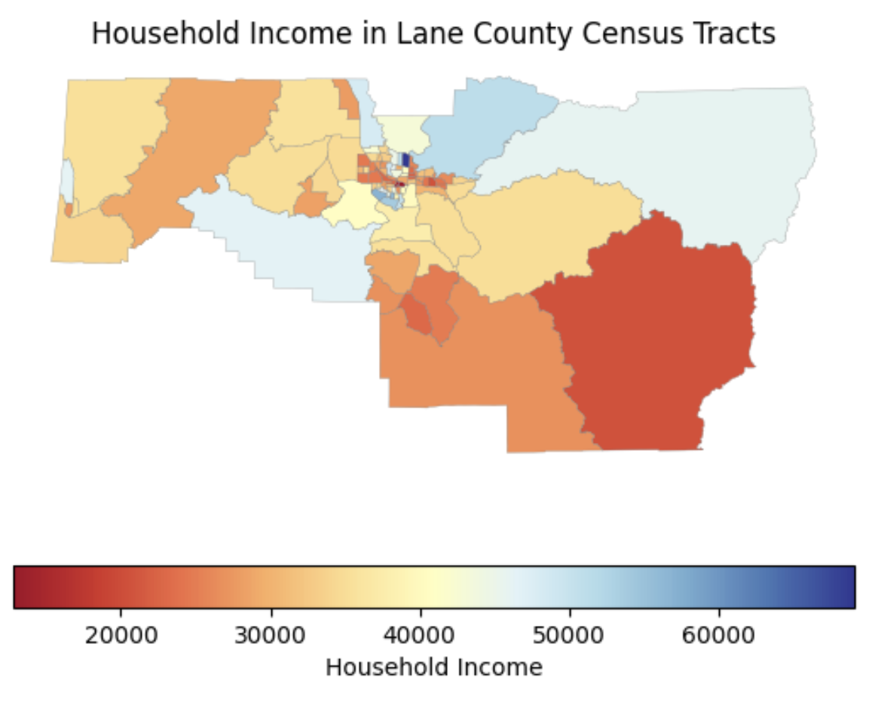
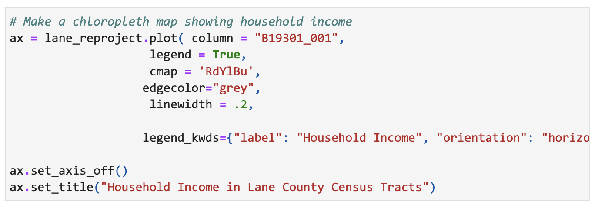
Code review: Assignment 2 and Activity 2

Slide 8
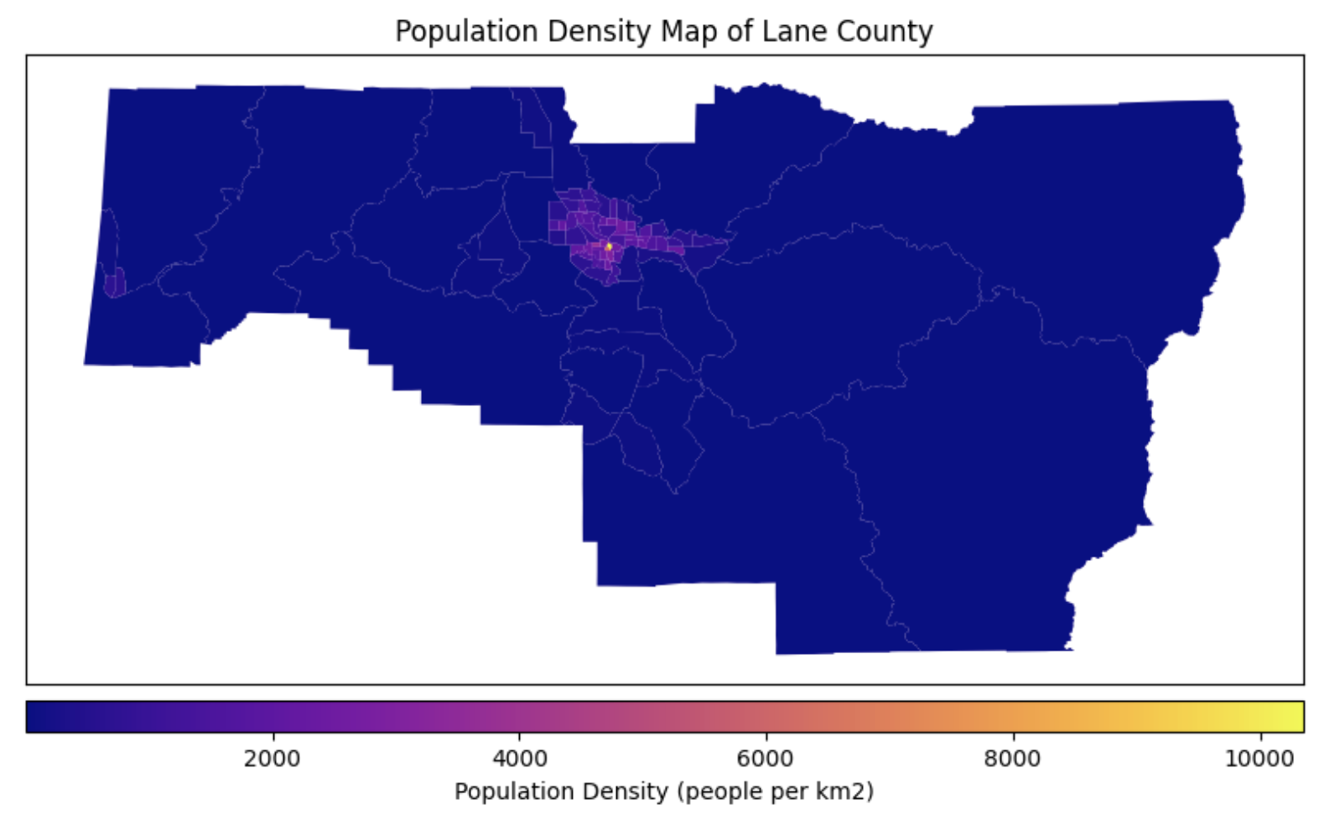
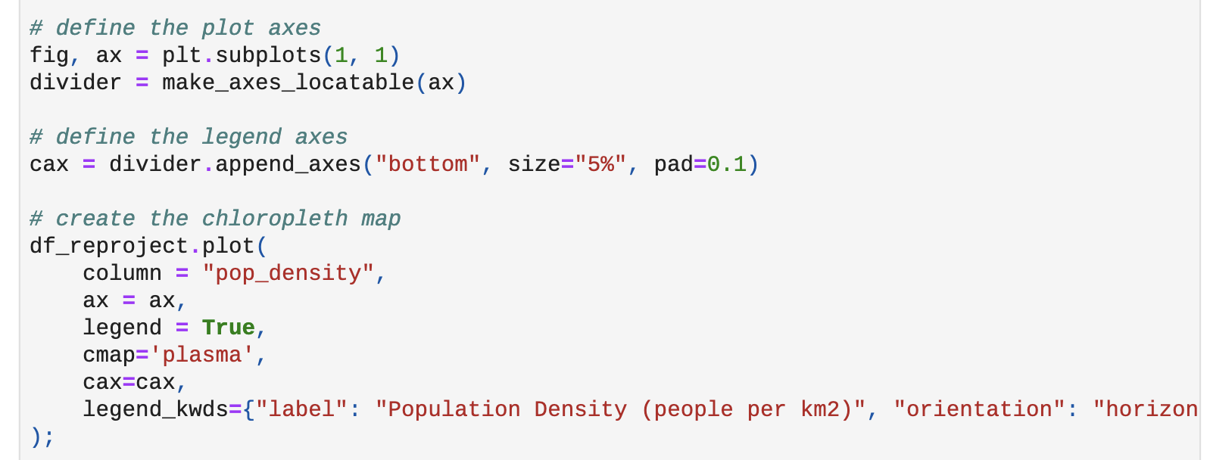
Code review: Assignment 2 and Activity 2
Notes:
Eliza – bravo bravissimo

Slide 9
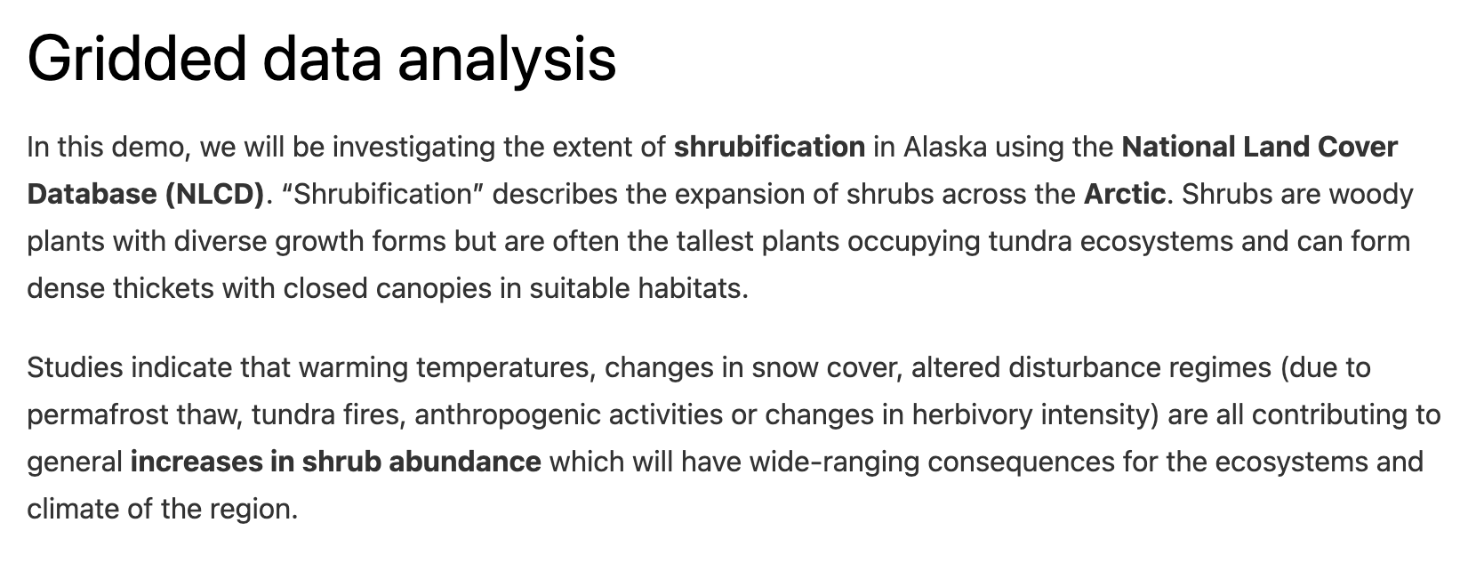
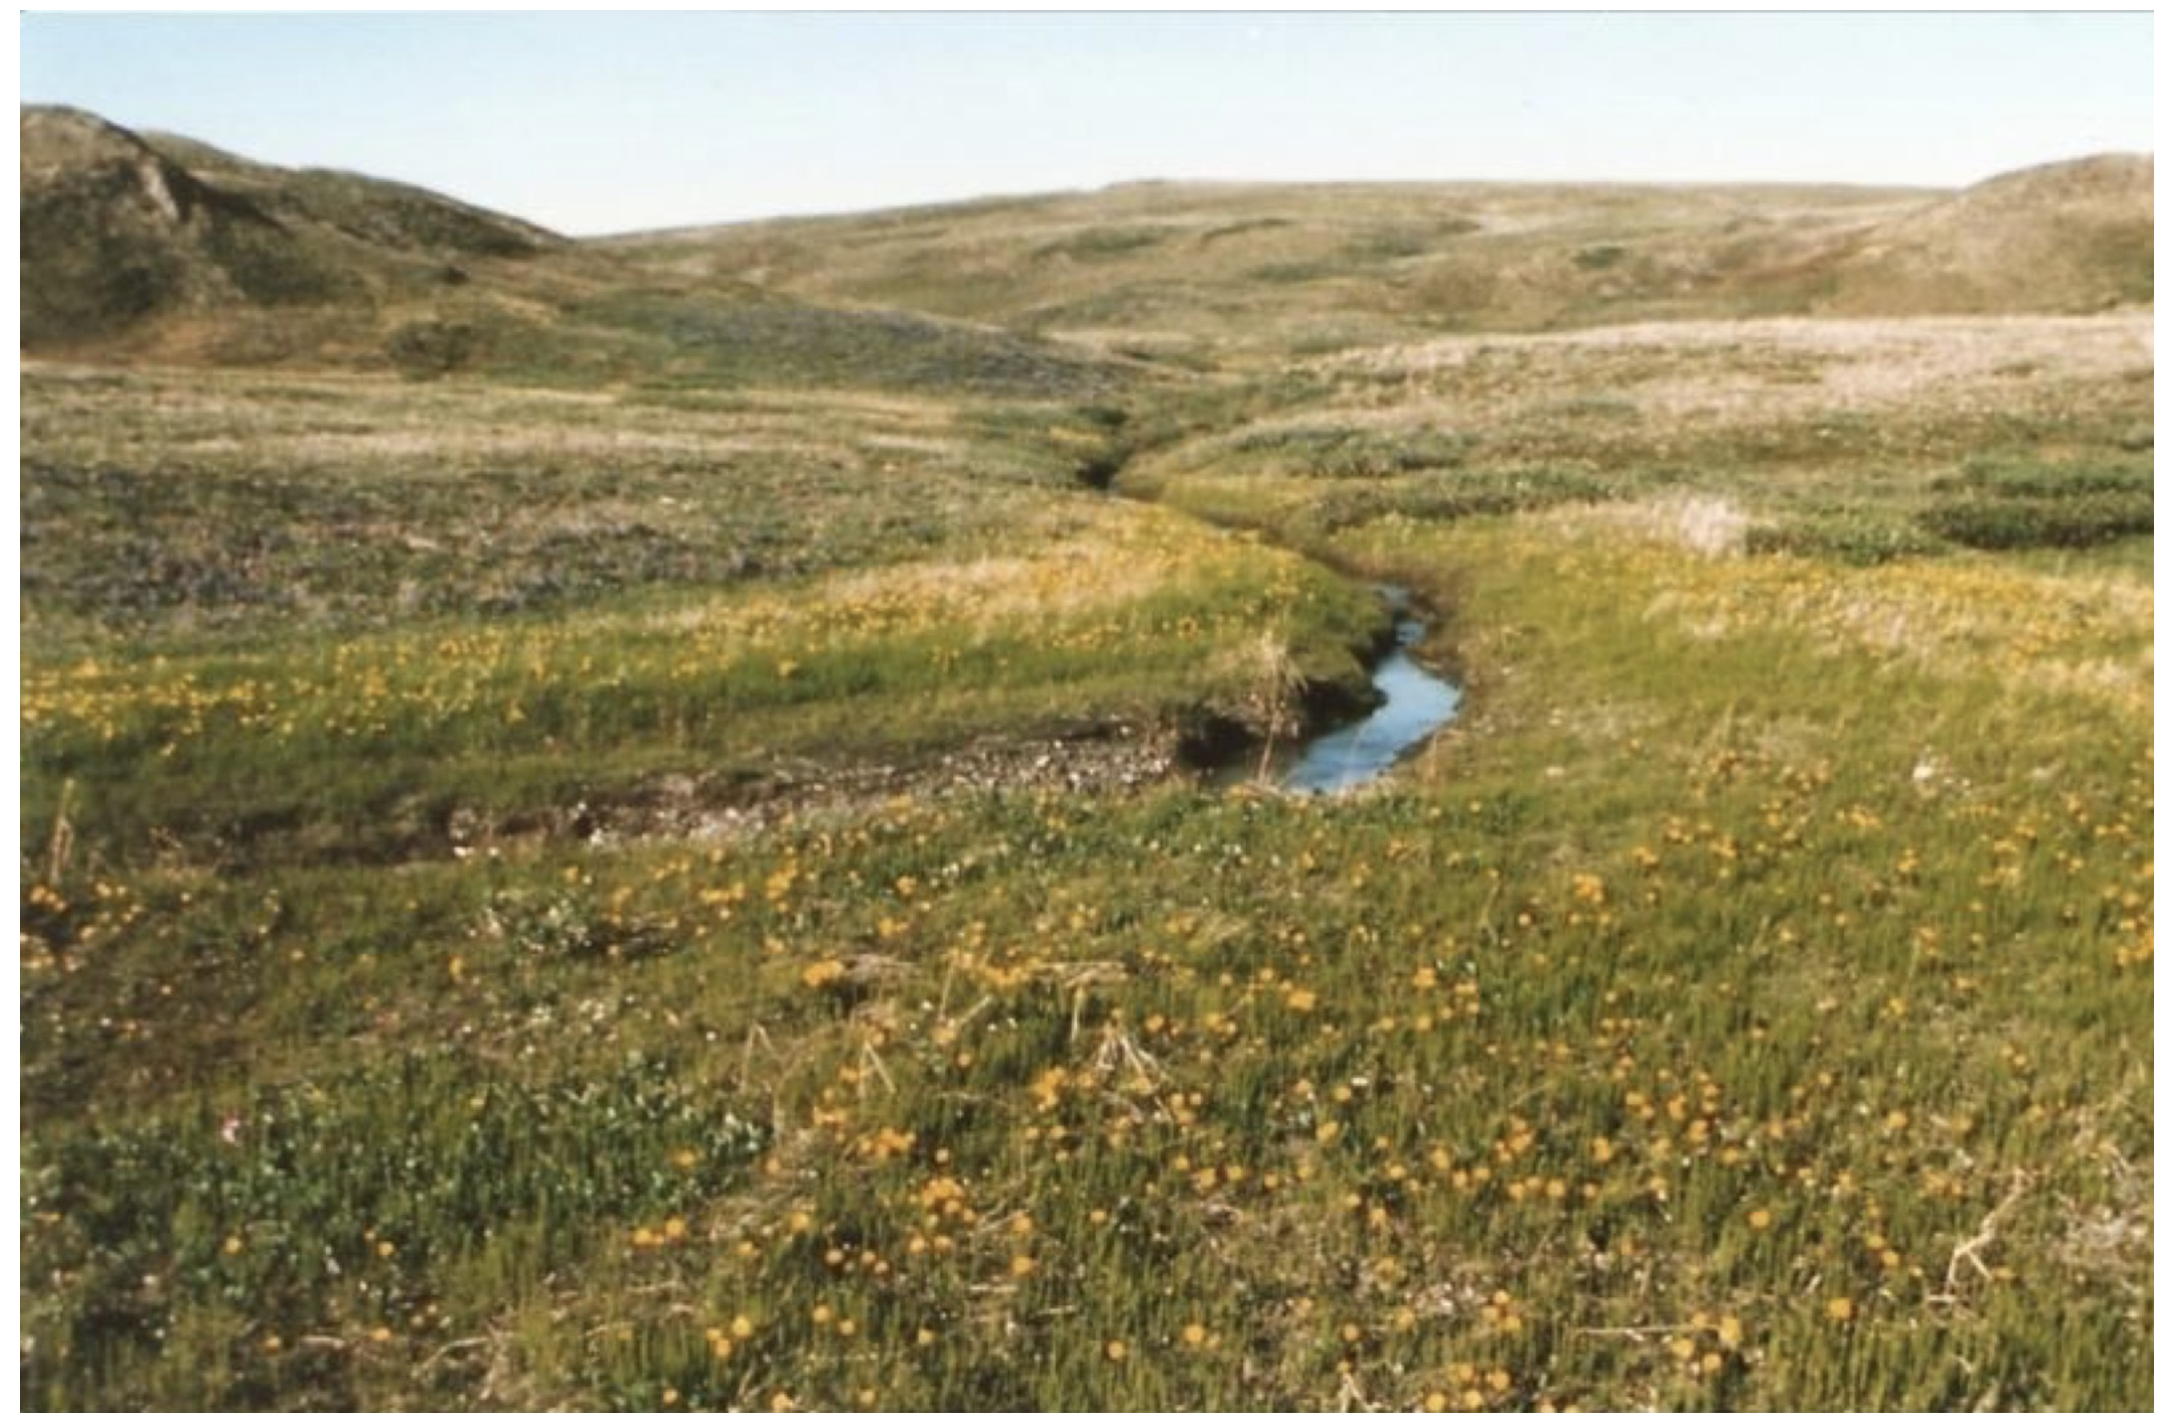
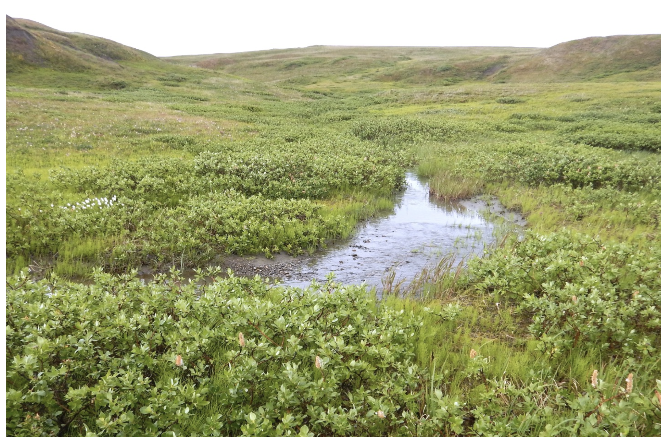
Notes:
The left photo was taken in 1987 and the right in 2017. Replacement of grasses with shrubs.

Slide 10
Notes:
Winners and losers – longer growing season might be good for birds but shrubs provide less nutrients for reindeer than grass.

Slide 11
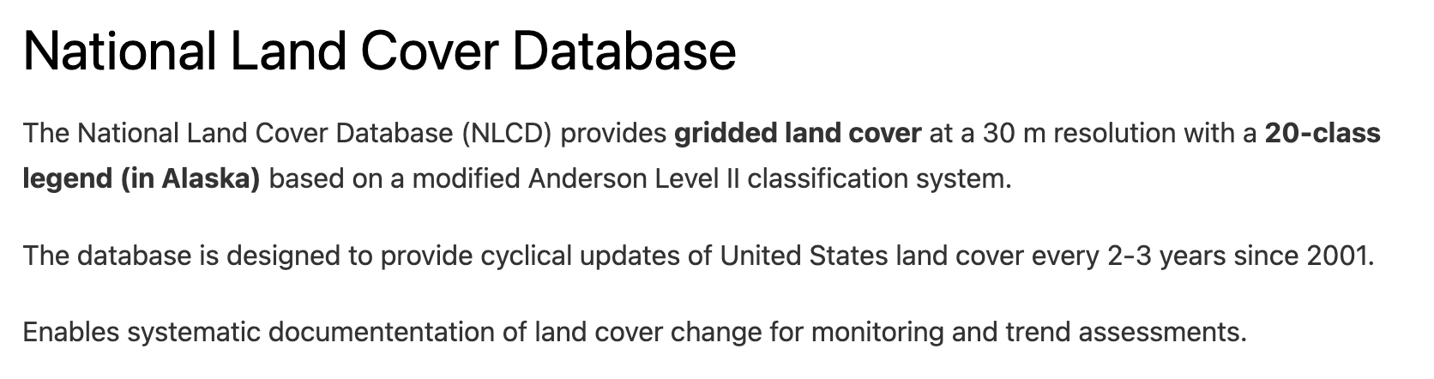
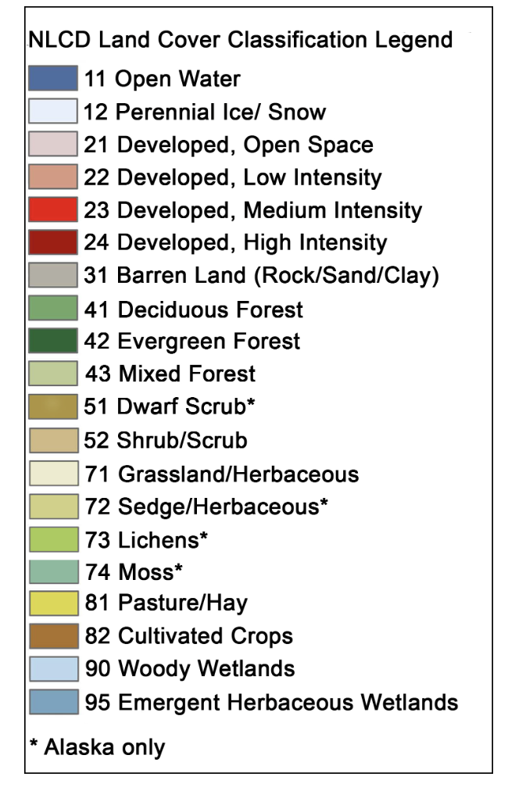
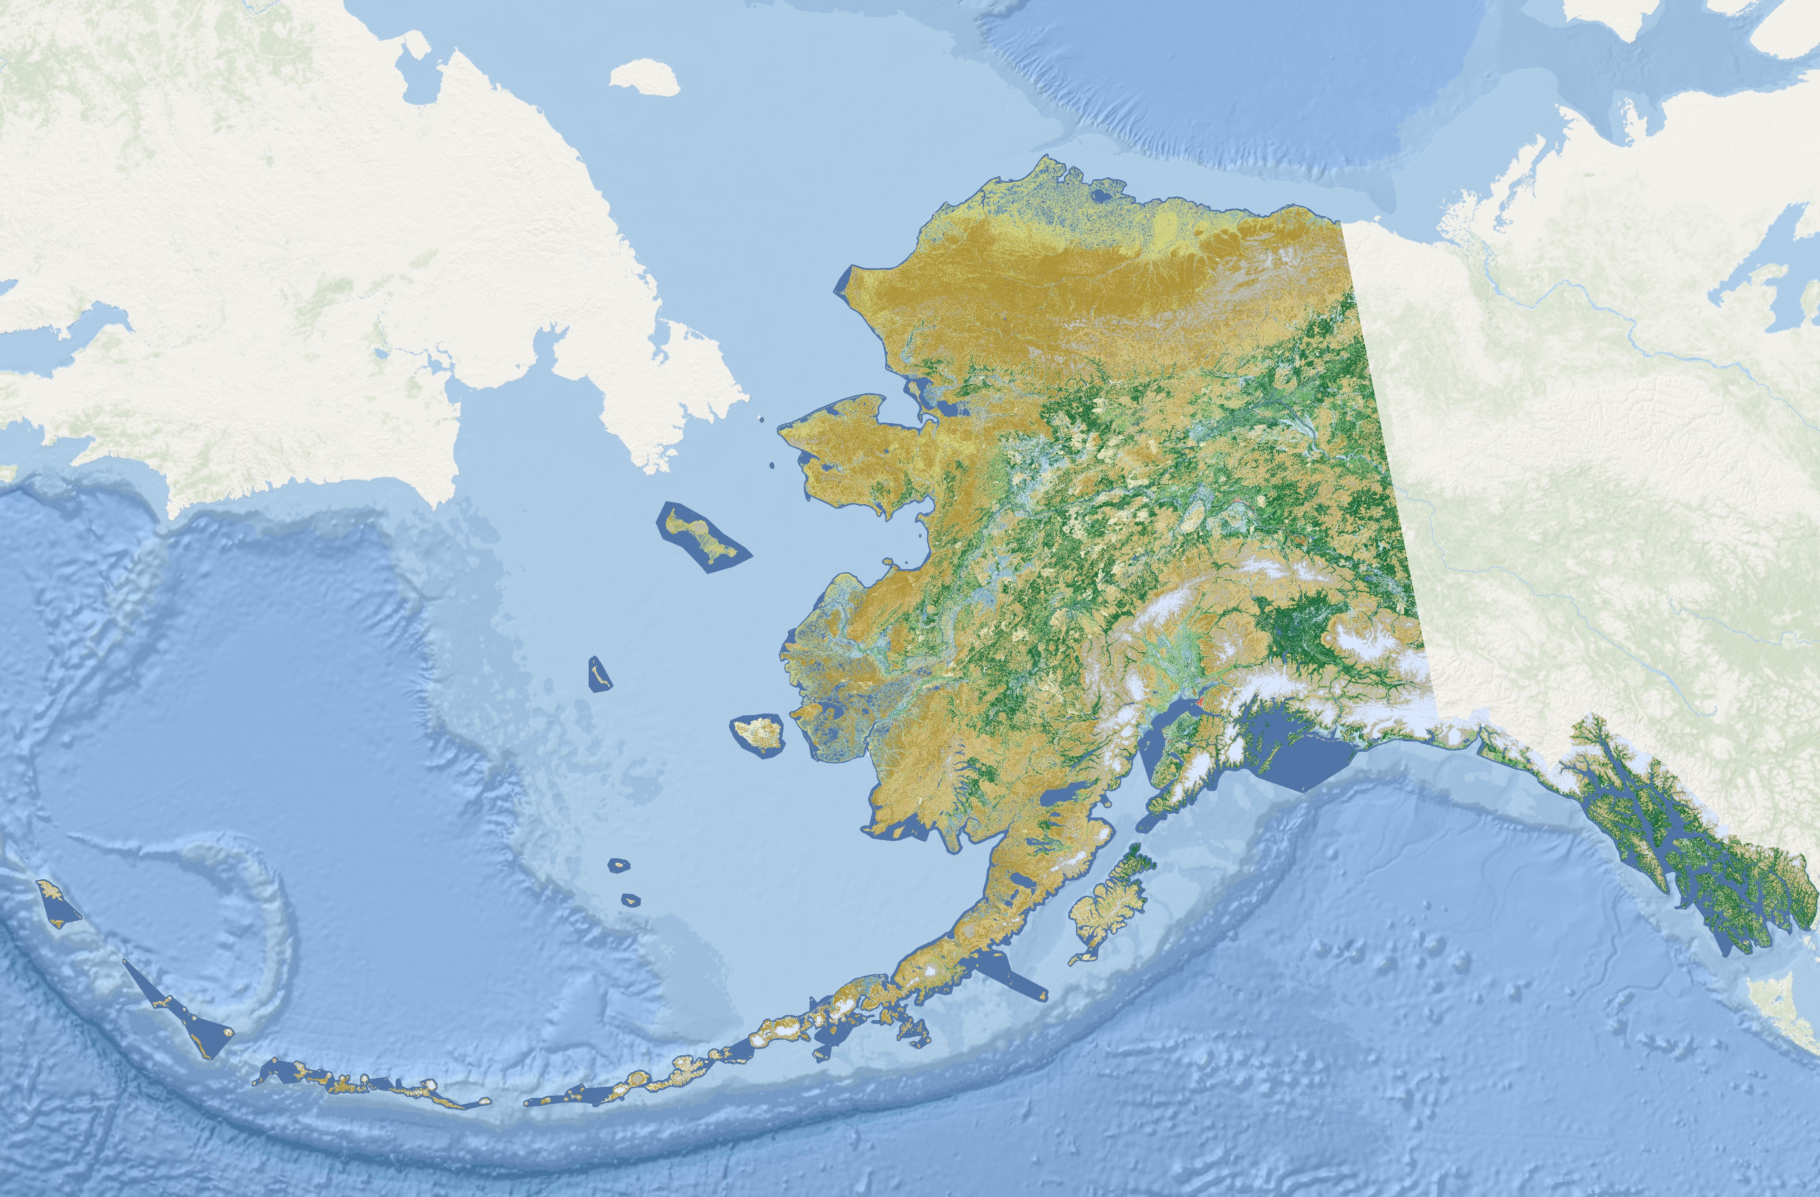

Slide 12
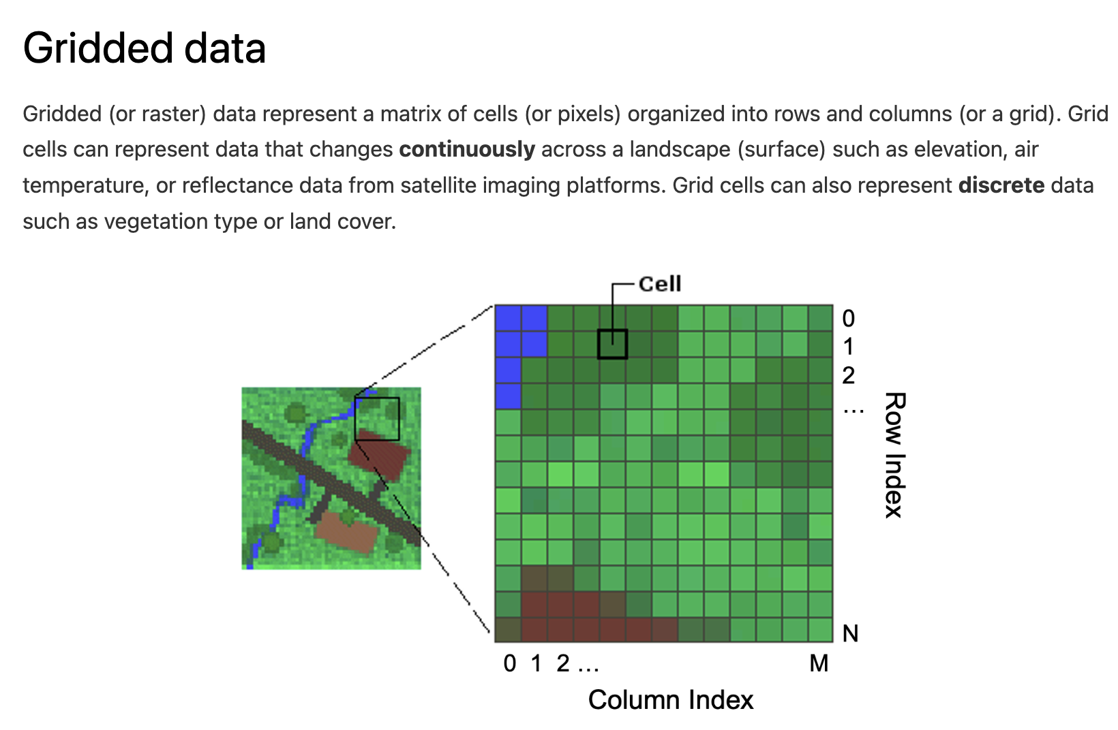

Slide 13
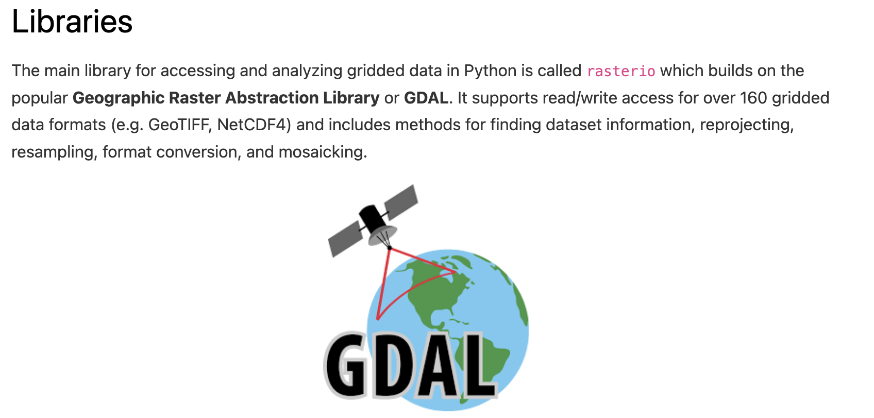

Slide 14
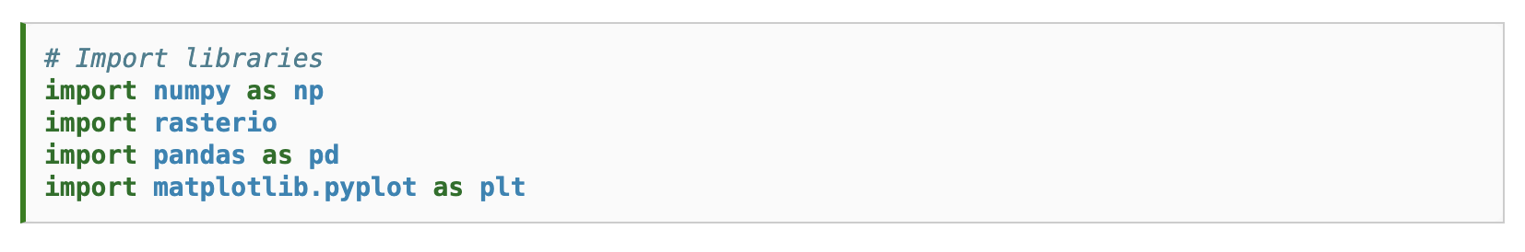

Slide 15
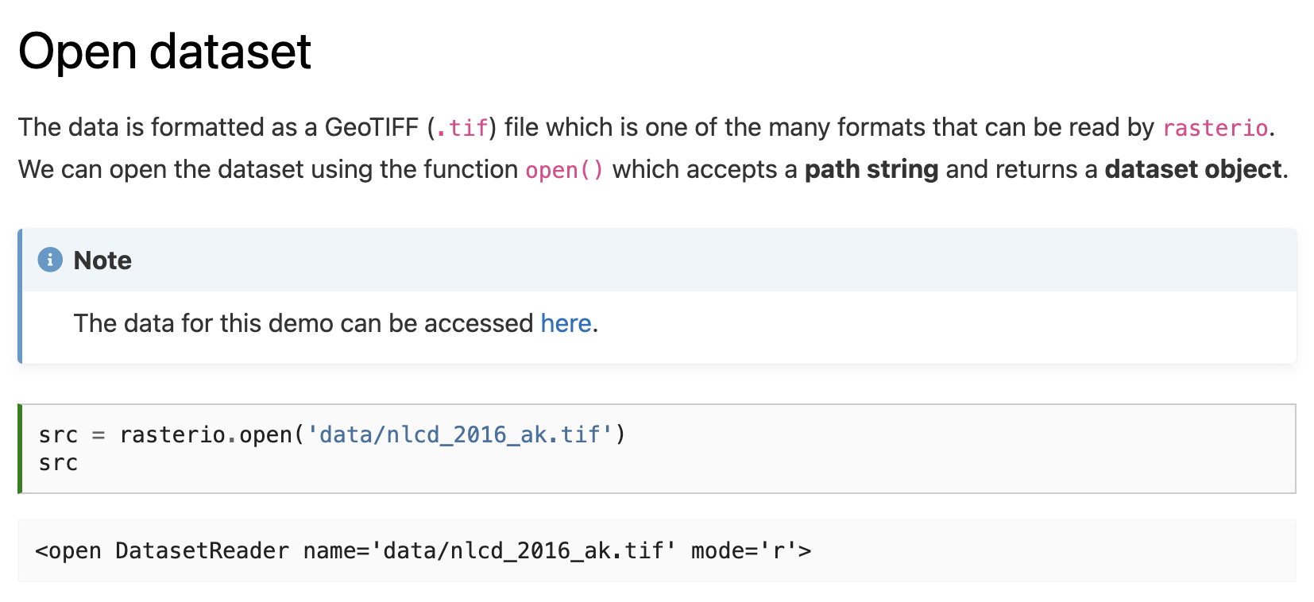

Slide 16
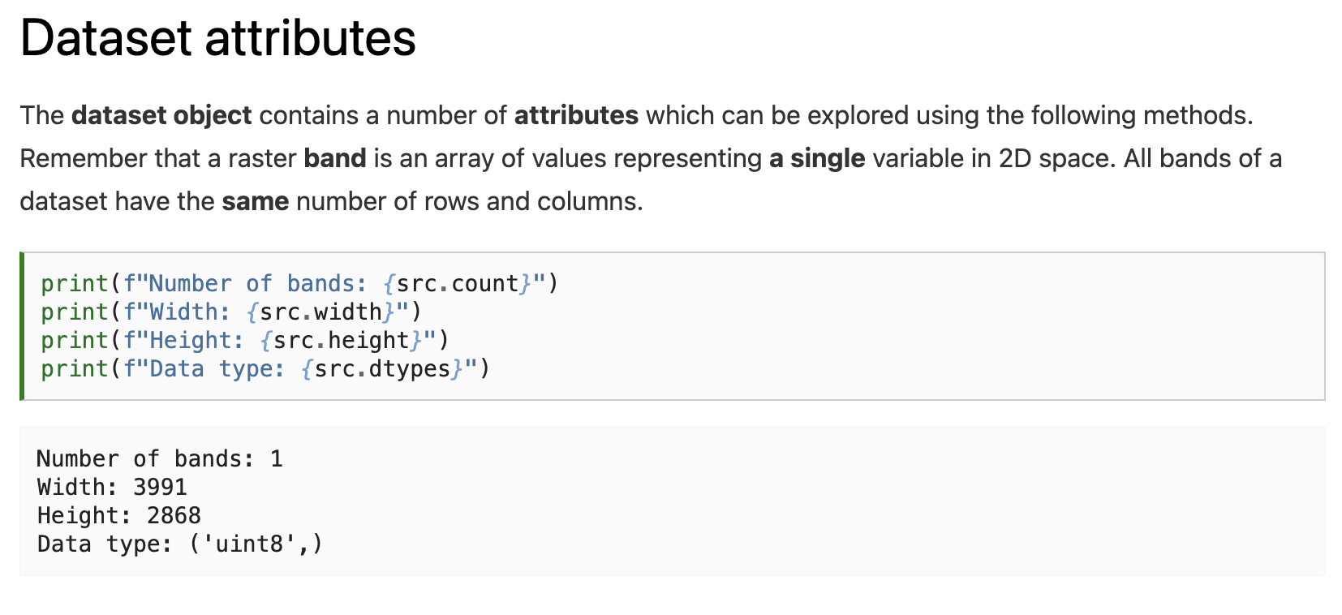
Notes:
How many different values can be stored in an uint8?

Slide 17
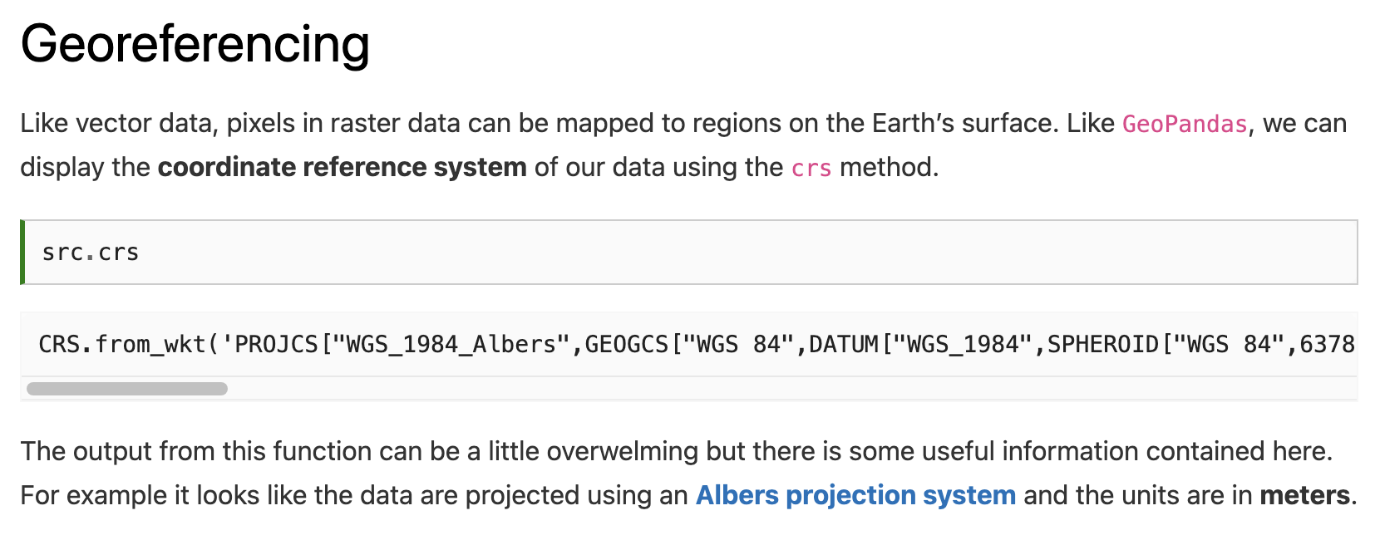

Slide 18
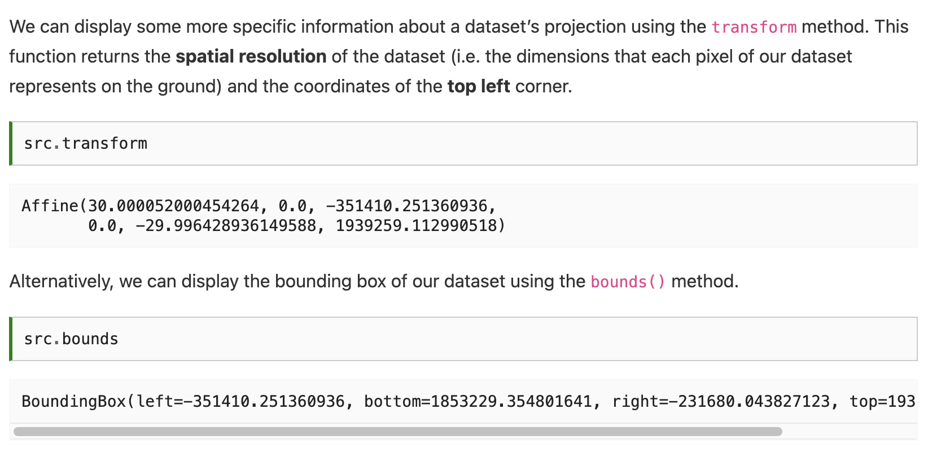

Slide 20
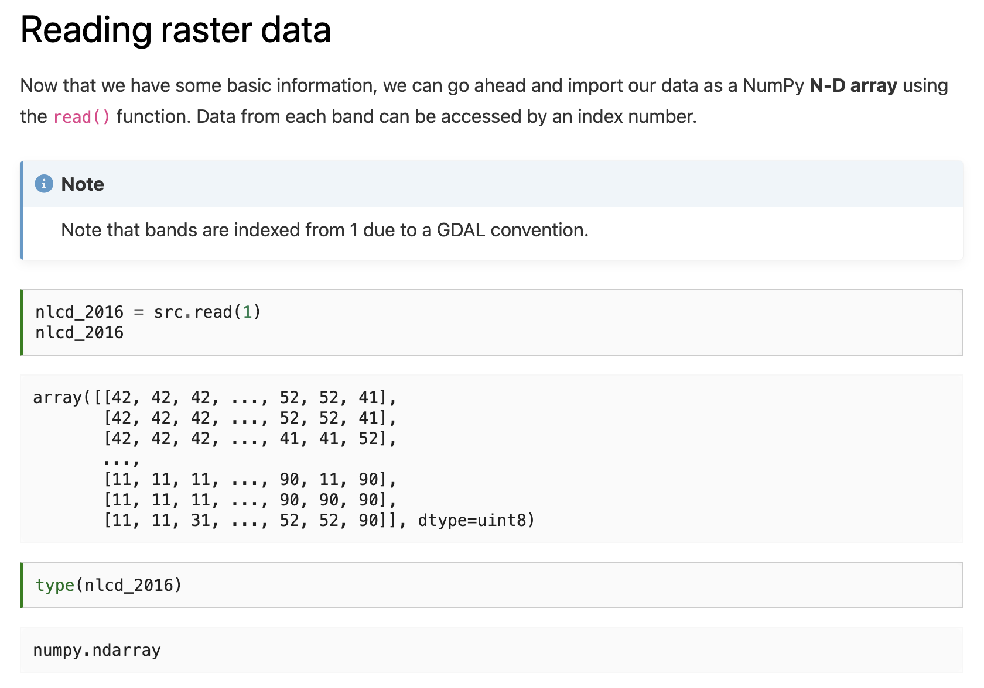

Slide 22
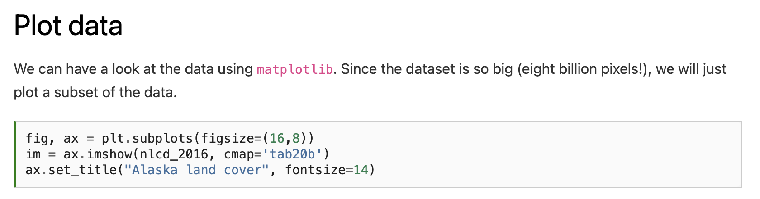
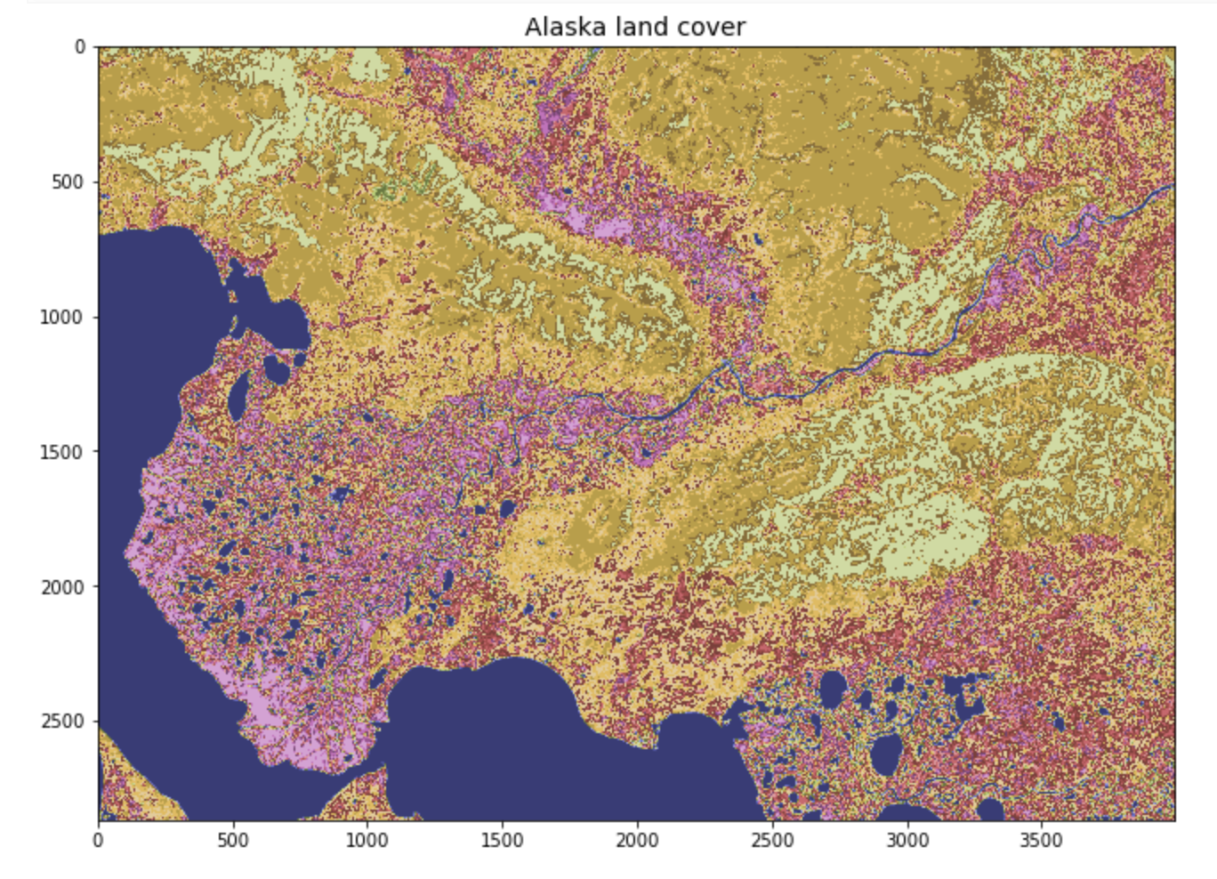

Slide 23
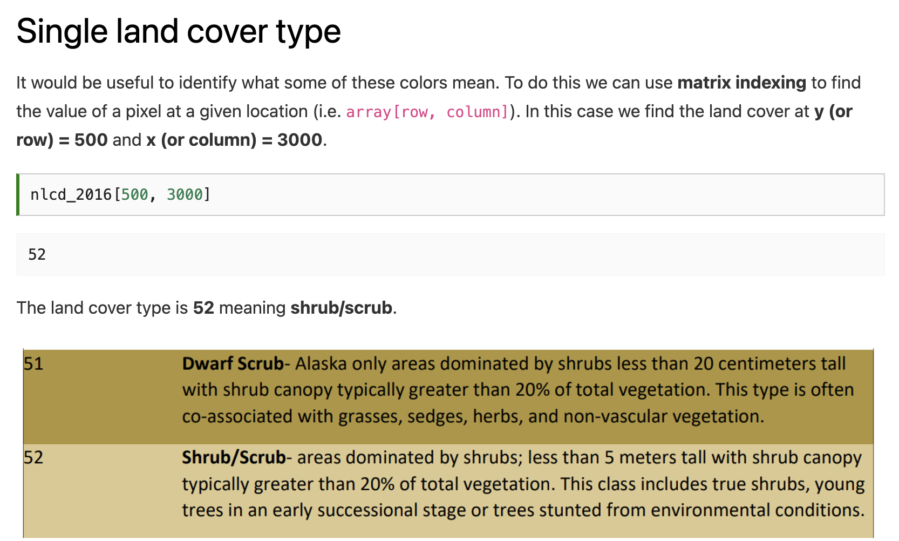

Slide 25
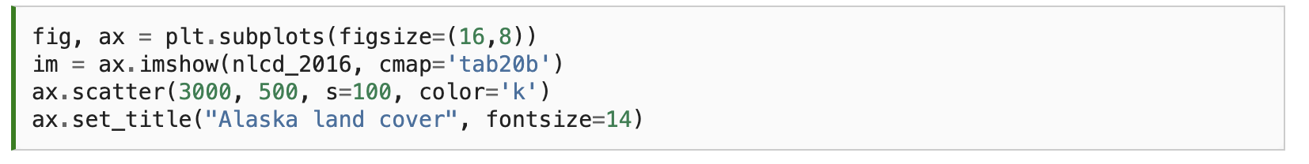
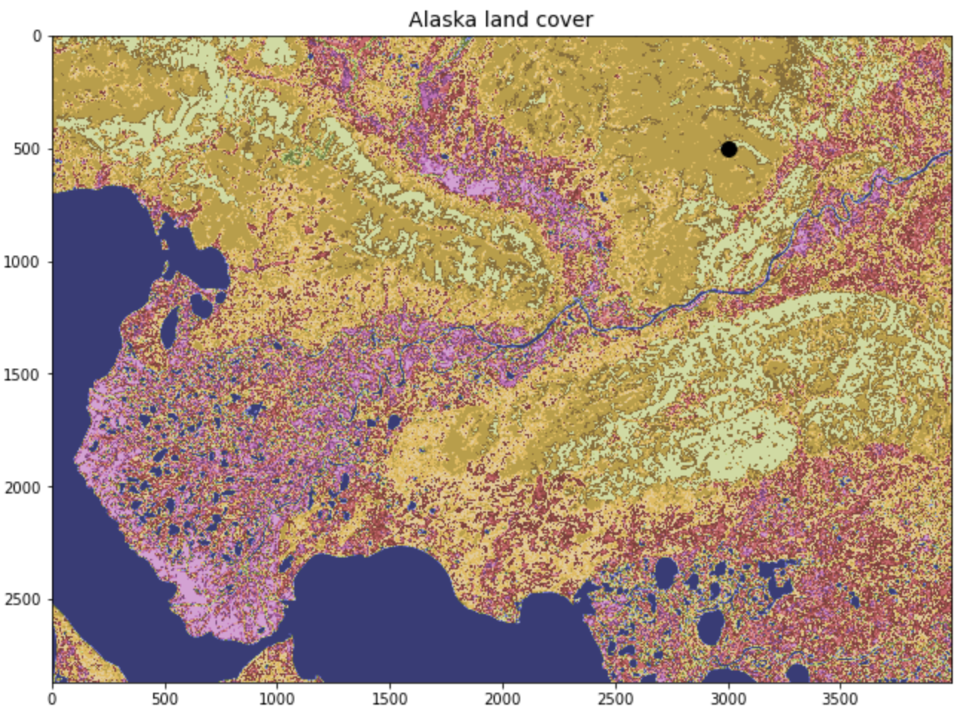

Slide 26
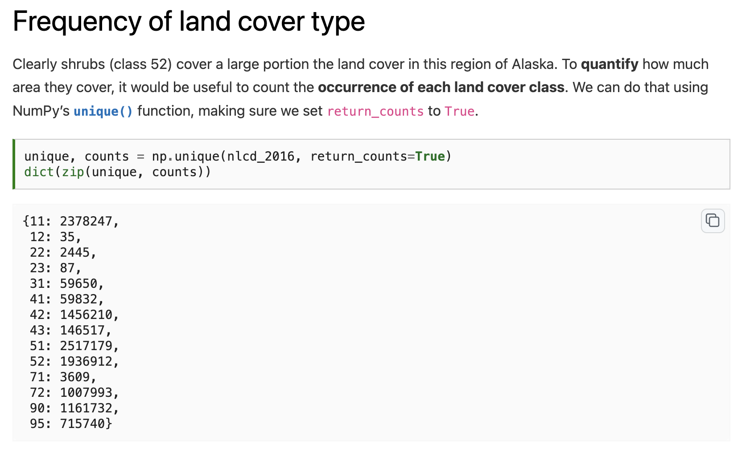

Slide 27
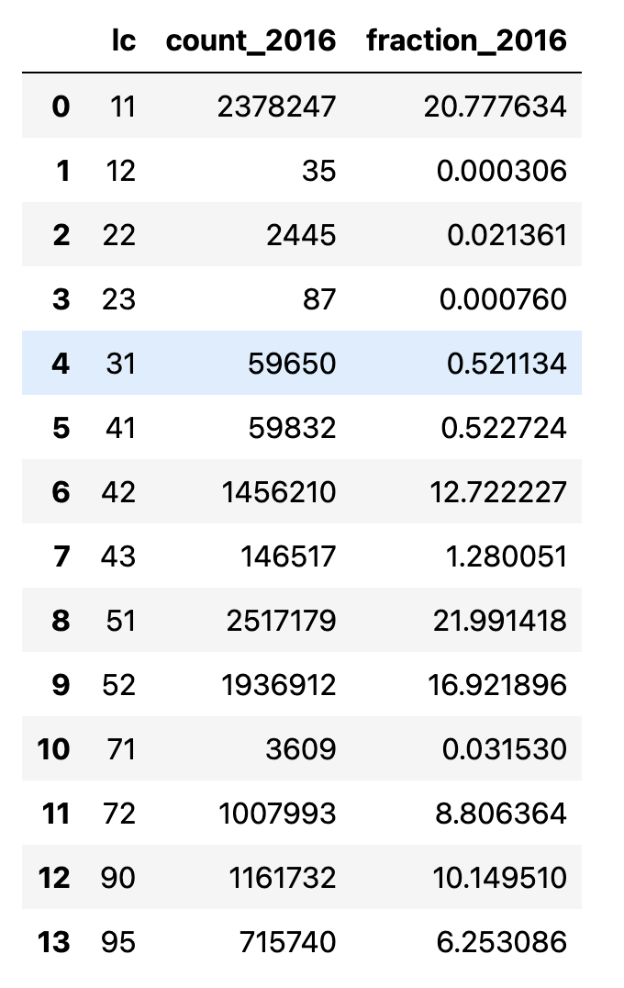
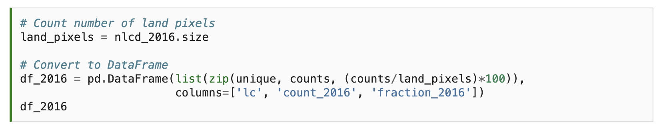
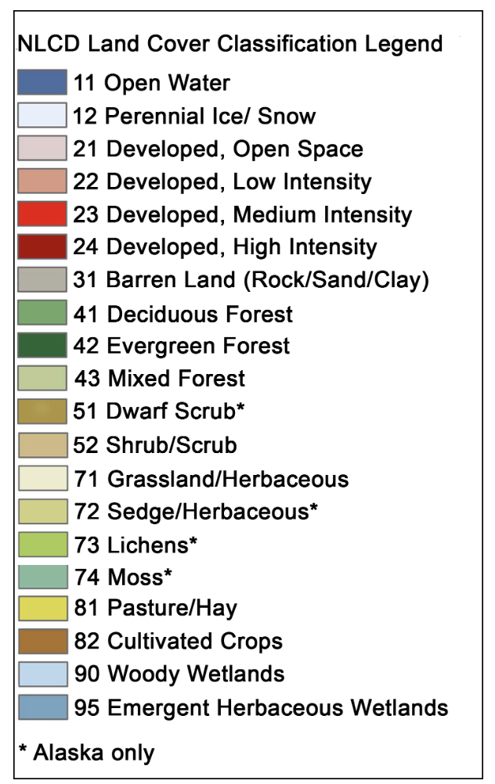

Slide 28
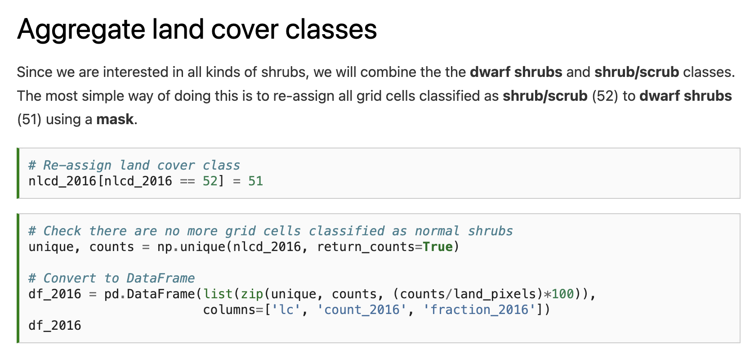

Slide 29
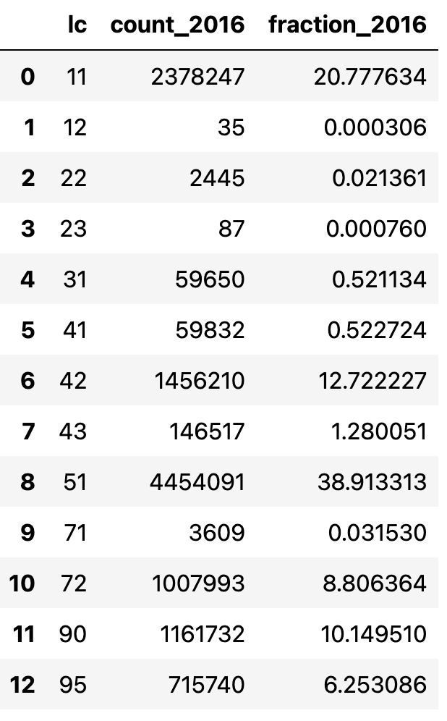

Slide 30
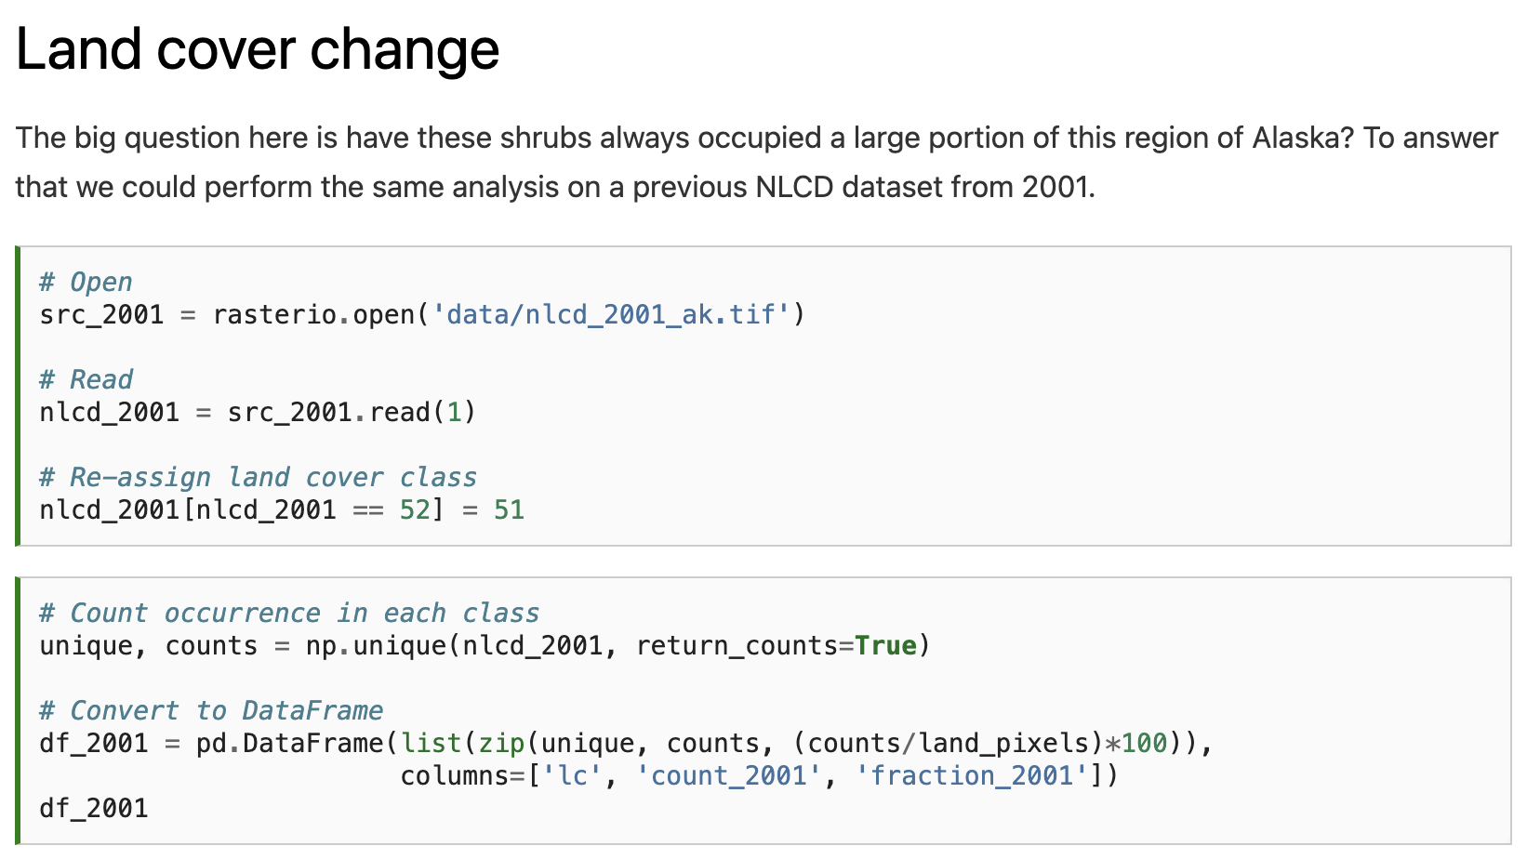
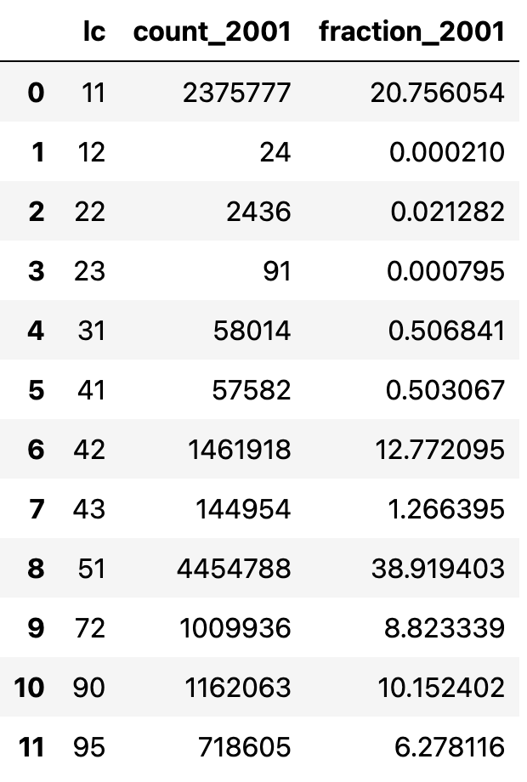

Slide 31
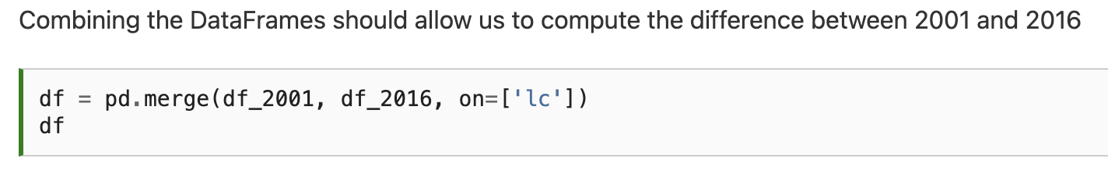
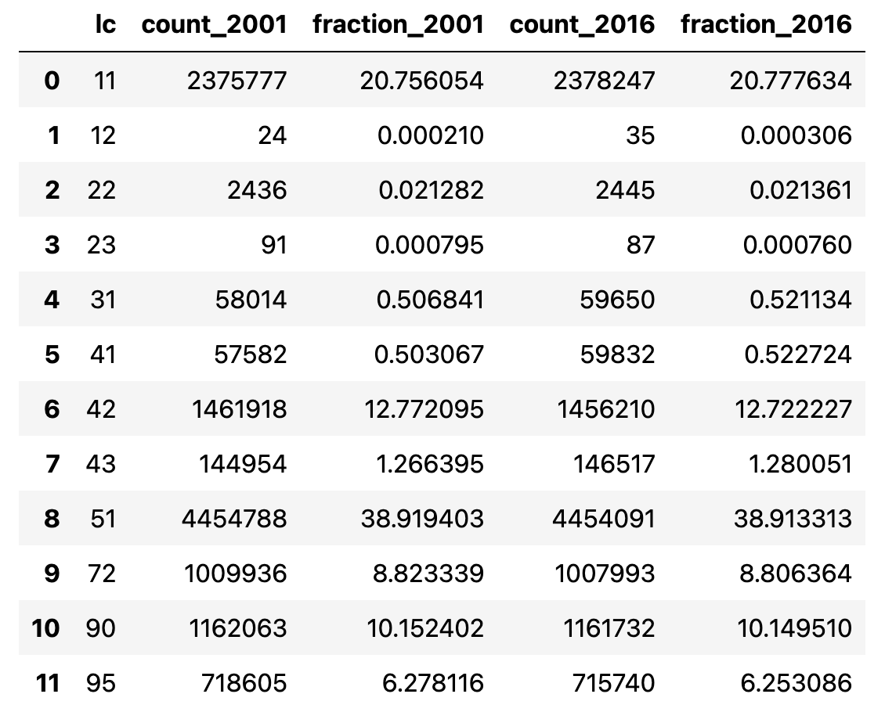

Slide 32
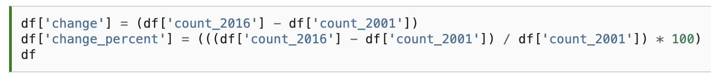

Slide 33
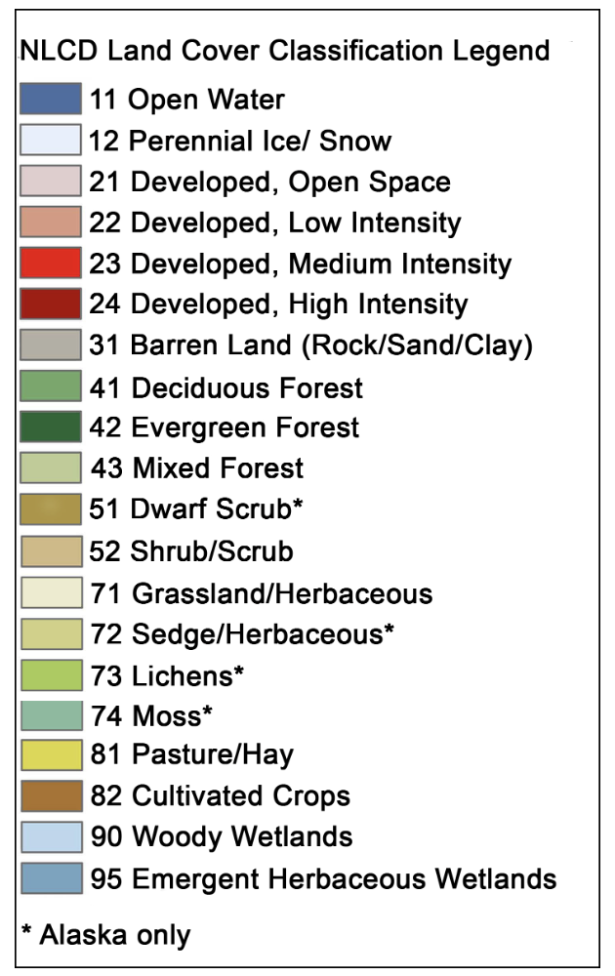
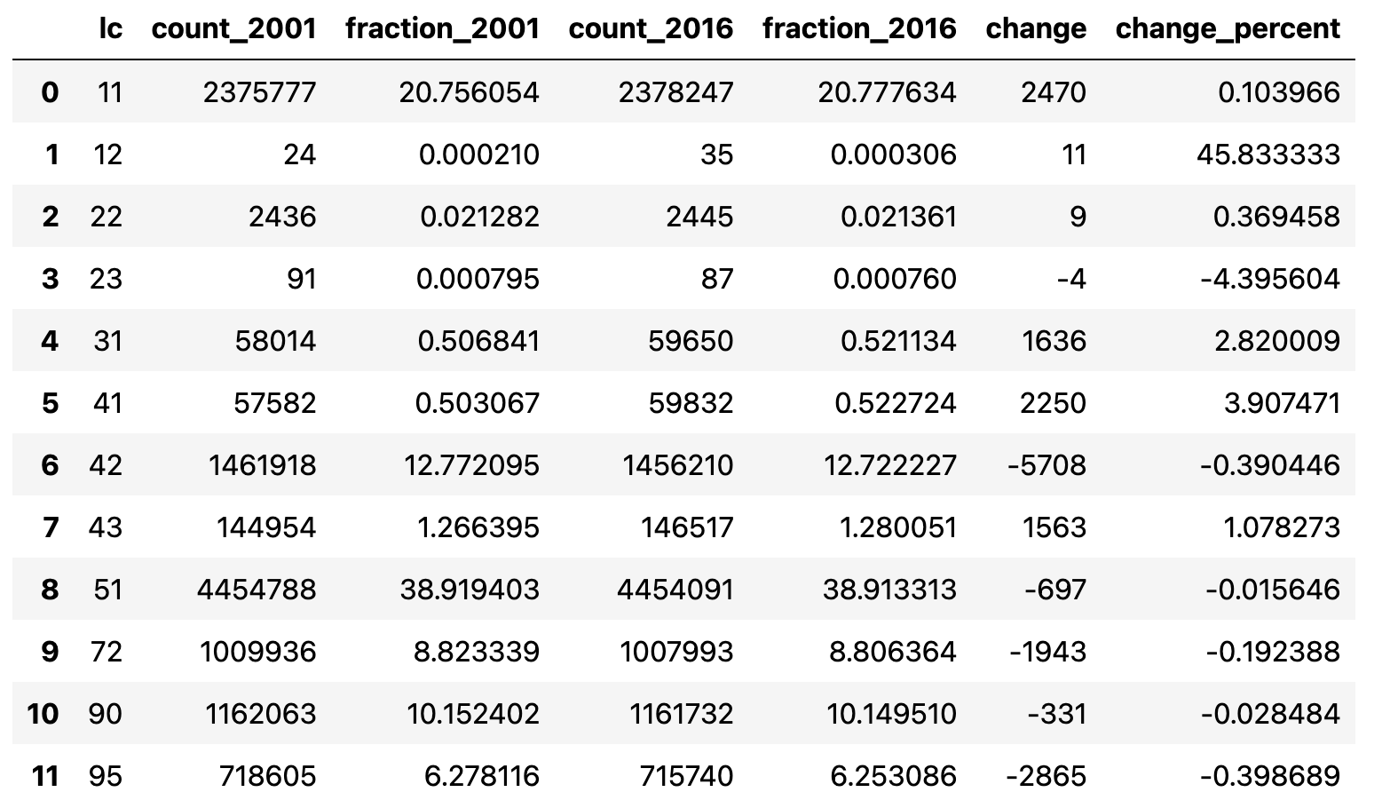
Notes:
Oh dear - the extent of shrubs did not increase between 2001 and 2016. One takeaway from this could be that shrubification is not happening in this region of the Arctic. But the percentage change in shrubs was very small (-0.02%) and could well be smaller than the uncertainty in our land cover product. For example, if just 1% of pixels were incorrectly classified as shrubs in 2001 our result would be insignificant. Other, perhaps more significant changes, that occurred between 2001 and 2016 include an increase in deciduous forest (41) by 3.9%, a decrease in evergreen forest (42) by 0.4%, and a decrease in emergent herbaceous wetlands (95) by 0.4%.

Slide 34
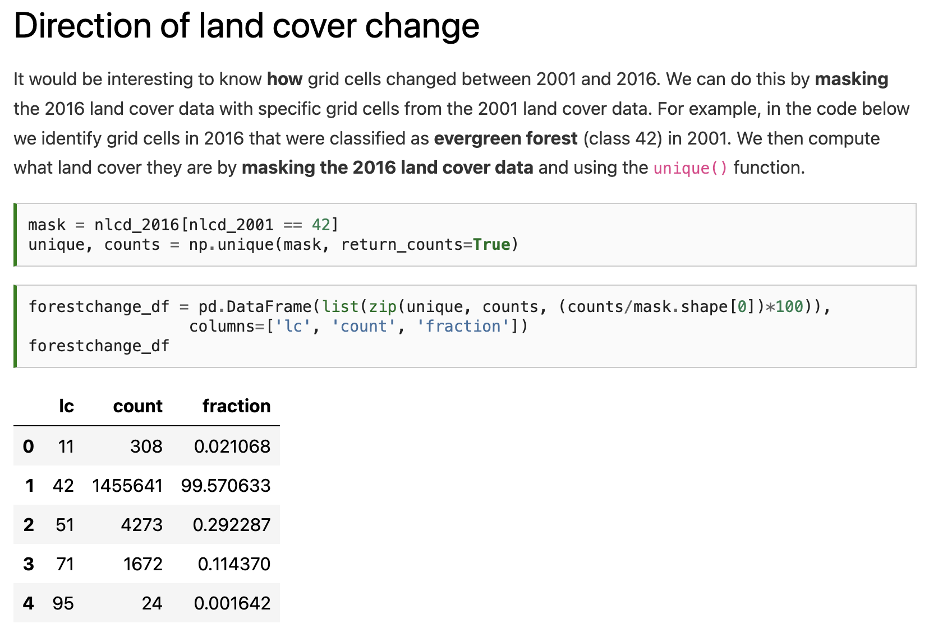

Slide 36
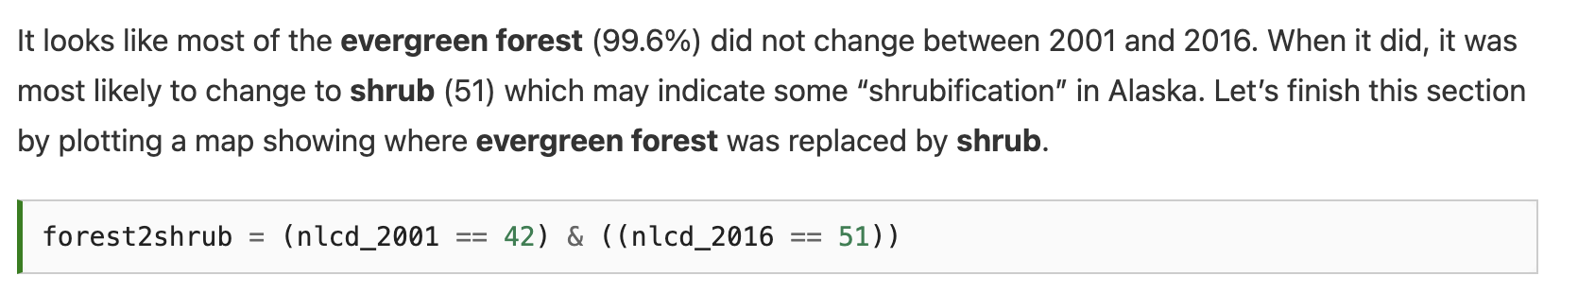

Slide 37
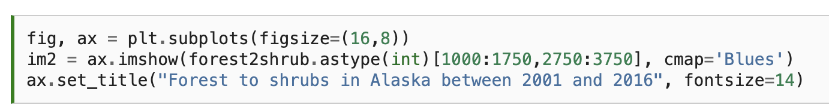
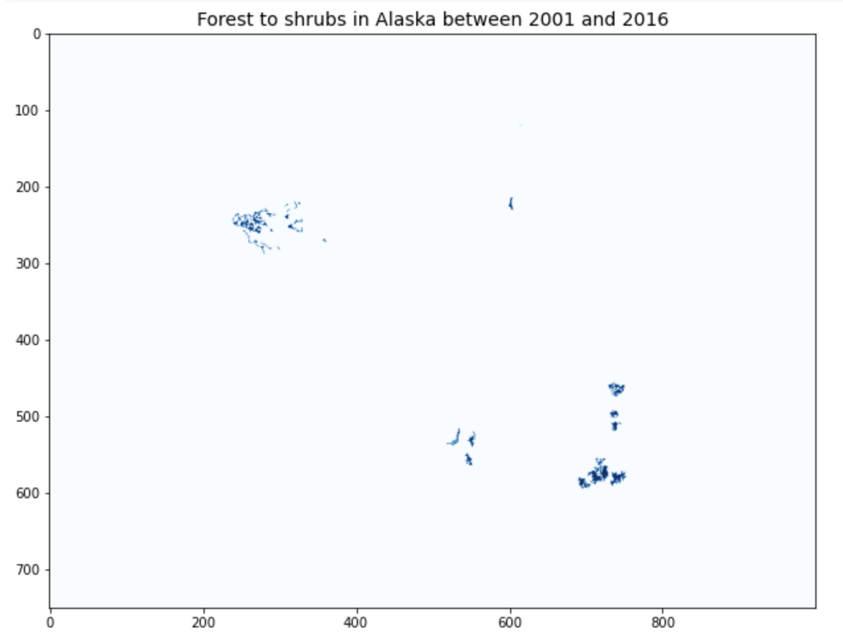

Slide 38
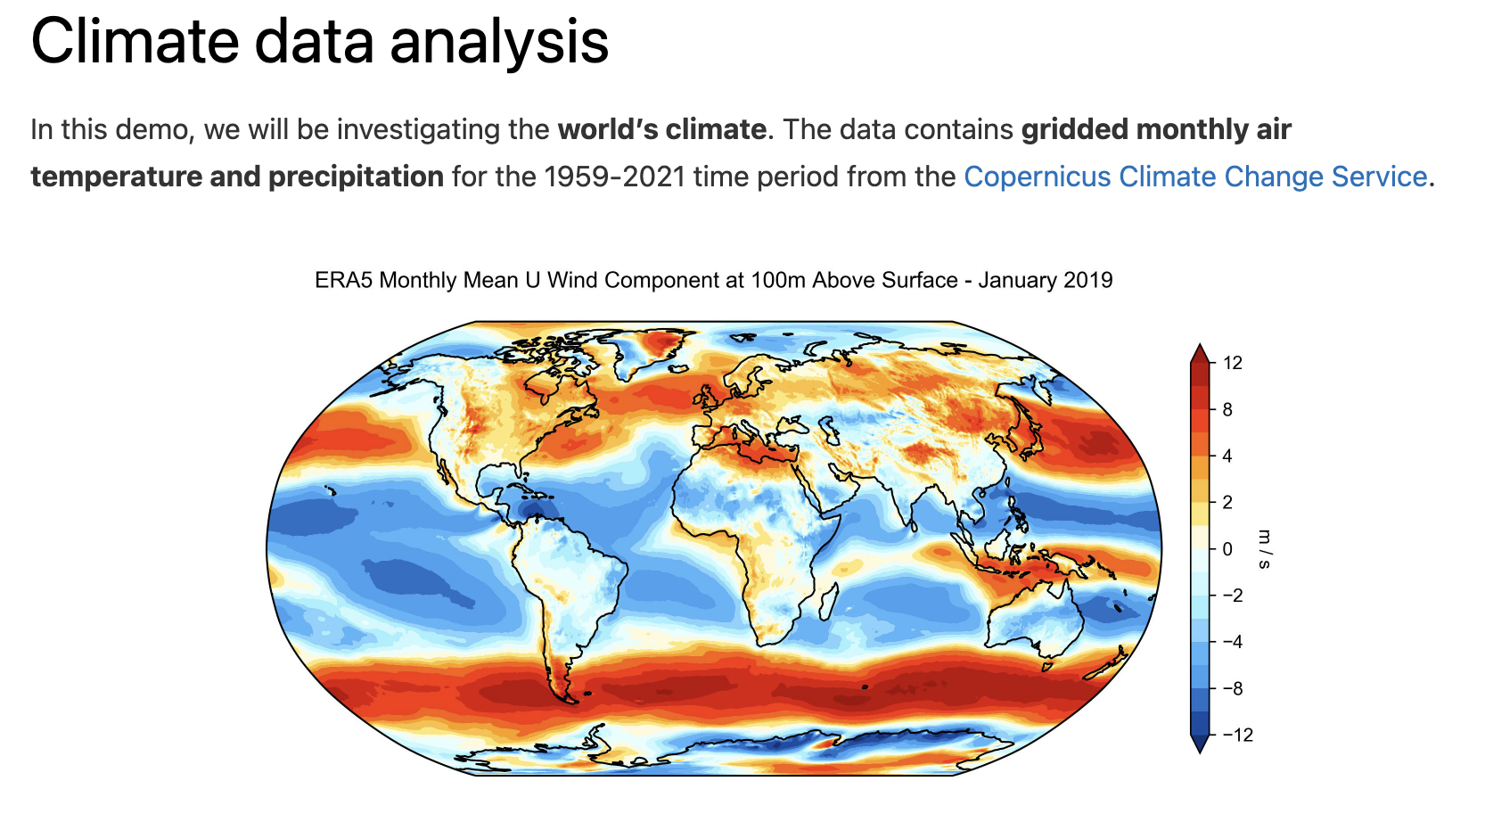

Slide 39
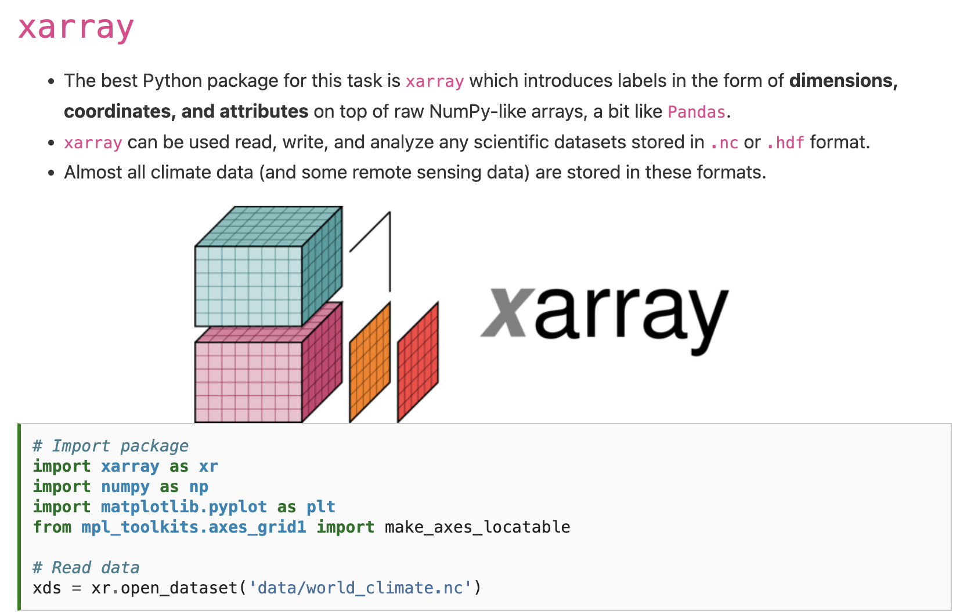

Slide 41
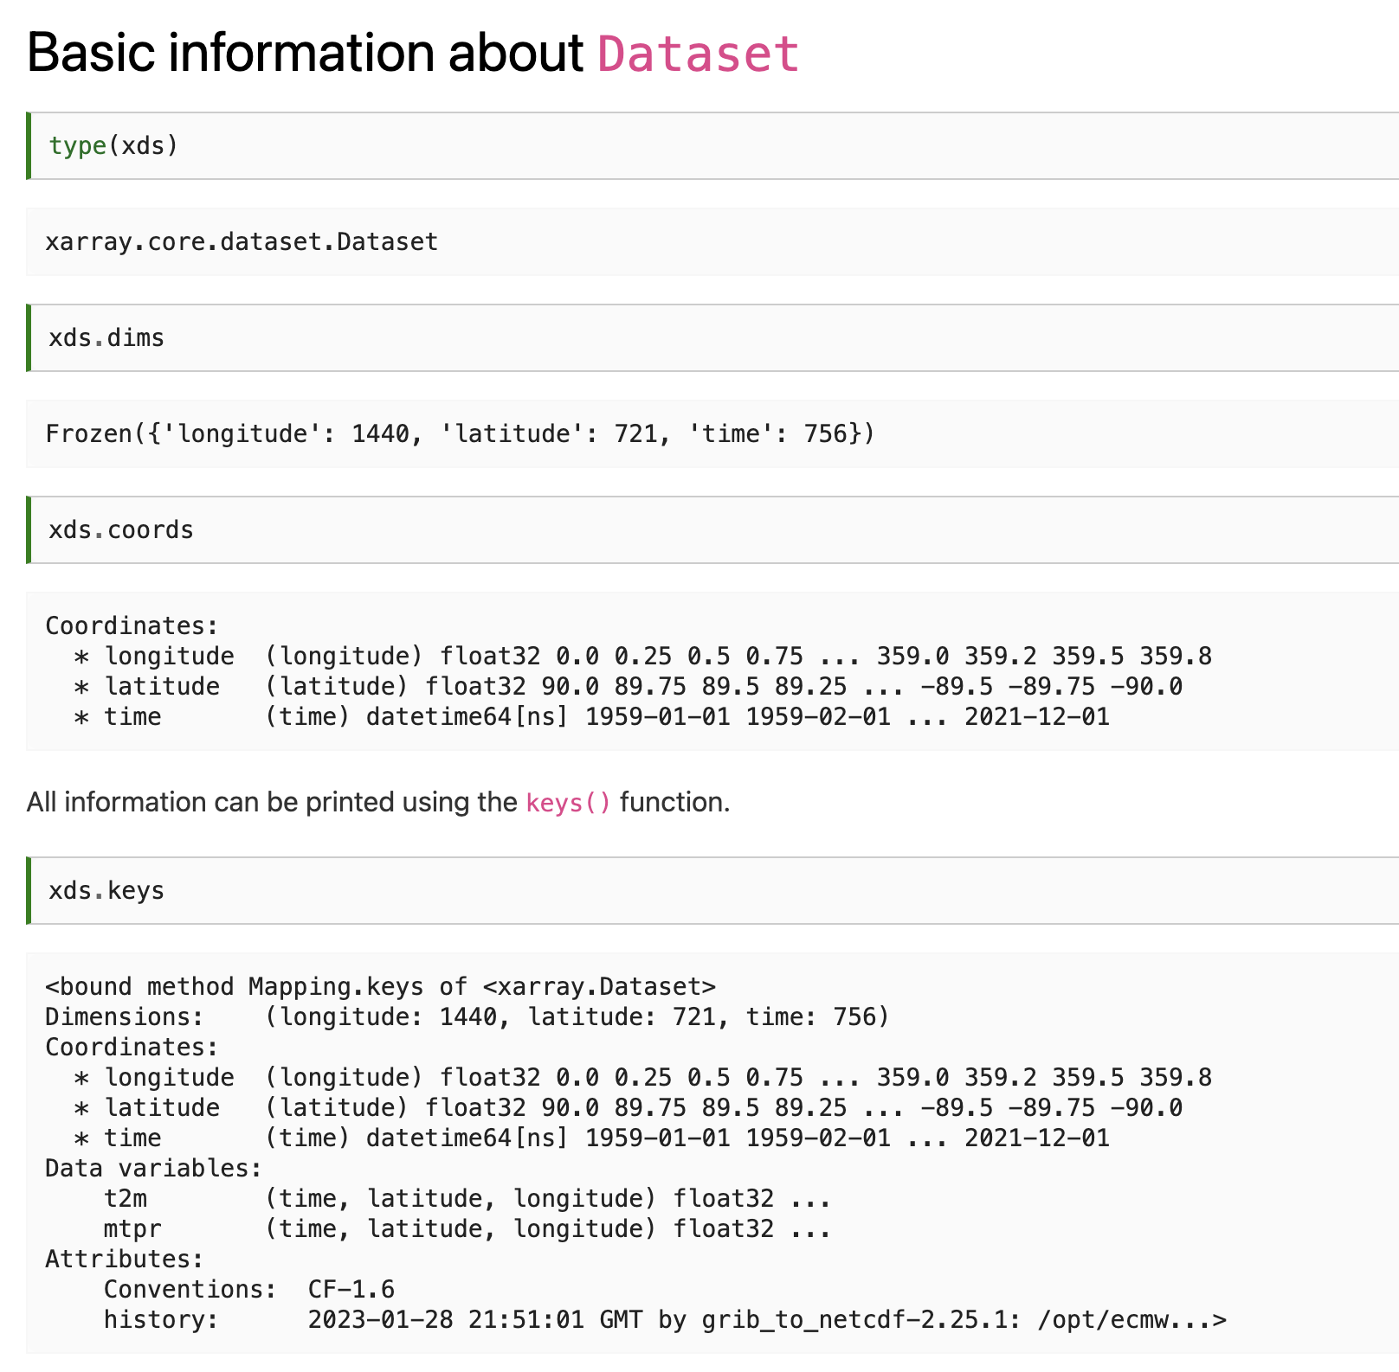

Slide 44
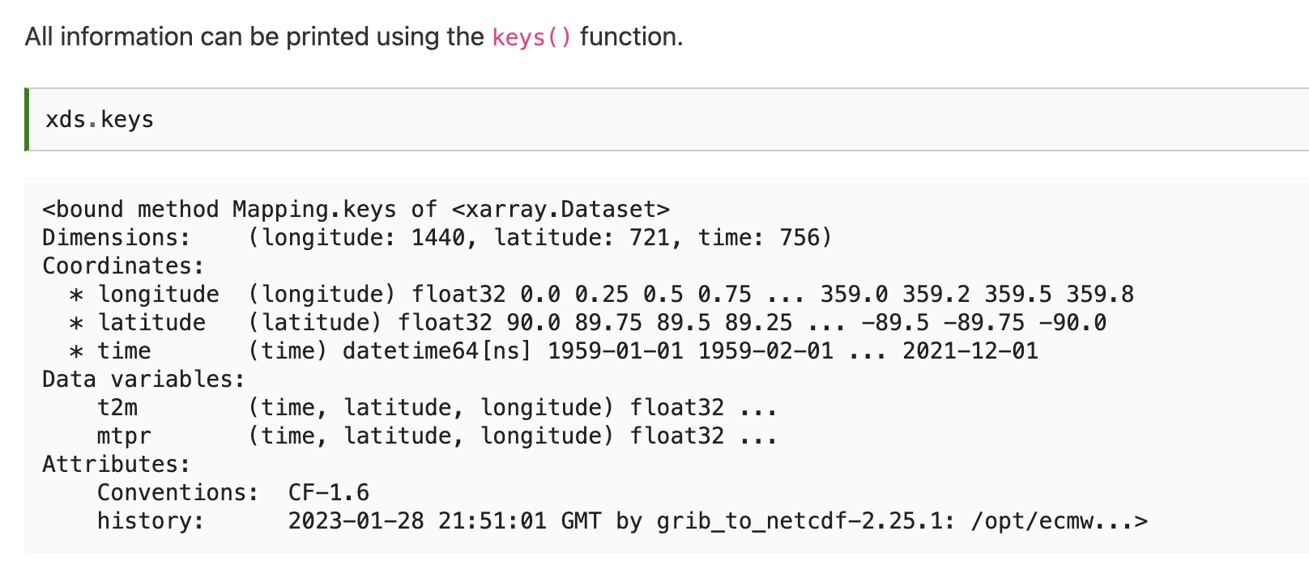
Notes:
t2m stands for 2 m above the surface, the standard height used by temperature sensors. It is a common metric used in climatology but note that it is different from the surface temperature which would be the temperature of the ground surface.

Slide 45

Notes:
\

Slide 46
Notes:
\

Slide 47
Notes:
\

Slide 48

Notes:
\

Slide 49
Notes:
\

Slide 50
Notes:
\

Slide 51

Notes:
\

Slide 52
Notes:
\

Slide 53
Notes:
\

Slide 54
Notes:
\

Slide 55

Notes:
\

Slide 56

Notes:
\

Slide 57

Notes:
\

Slide 58

Notes:
\

Slide 59

Notes:
\

Slide 60

Notes:
\

Slide 61
Notes:
\

Slide 62
Notes:
\

Slide 63


Notes:
\

Slide 64

Notes:
\

Slide 65
Notes:
\

Slide 66

Notes:
\

Slide 67
Notes:
\

Slide 68

Notes:
\

Slide 69
Notes:
\

Slide 70


Slide 71
Thursday: Previous final projects
Email: jryan4@uoregon.edu
Office: 163A Condon Hall
Office hours: Monday 15:00-16:00 and Tuesday 14:00-15:00

